Slide 1
Virtual Memory
— Chapter 9
2021年11-12月
叶 文
yewen@bupt.edu.cn
School of Computer Science (National Pilot Software Engineering School)

Slide 2
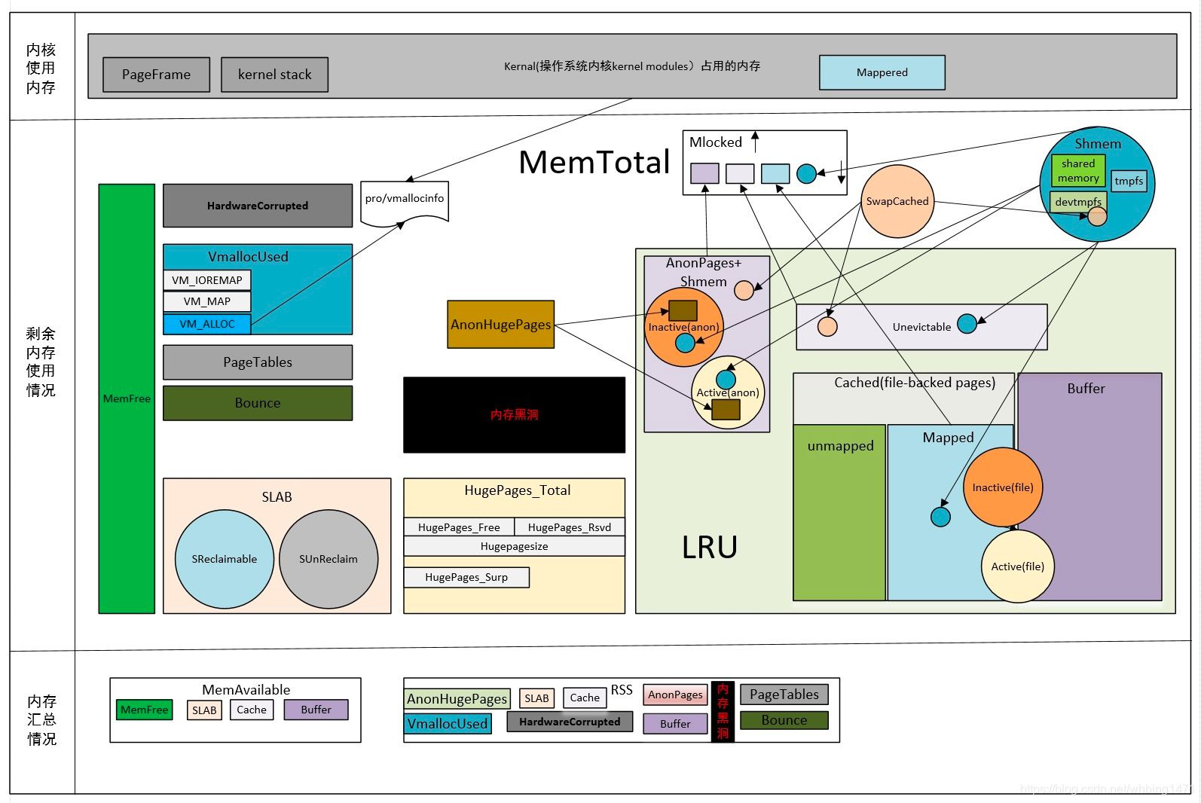
Memory Management in Linux

Slide 3
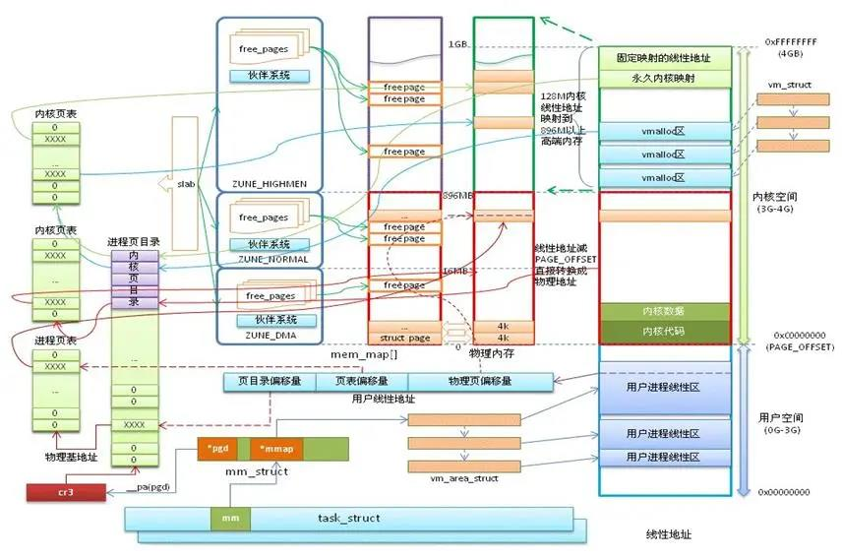
Linux内存管理

Slide 4
Outline
Background
Demand Paging
Copy-on-Write
Page Replacement
Allocation of Frames
Thrashing
Memory-Mapped Files
Allocating Kernel Memory
Other Considerations
Operating-System Examples: Linux

Slide 5
Objectives
To describe the benefits of a virtual memory system
To explain the concepts of demand paging, page-replacement algorithms, and allocation of page frames
To discuss the principle of the working-set model
To examine the relationship between shared memory and memory-mapped files
To explore how kernel memory is managed

Slide 6
Introduction
For executing processes, the instructions being executing must be in physical memory
memory mechanisms in Chapter 8 , such as contiguous allocation and noncontiguous allocation(e.g. paging, segmentation) meet this strict requirement by loading all the process into memory once at a time before the process begins to run
however, in the memory mechanisms mentioned above, logical address space is limited by the memory size, or by the physical address space
Virtual memory (or VM) is a memory management scheme that
allows the logical address space of processes to be larger than the available physical address spaces !
thus, enables the processes which may not be completely in memory to be executed
only parts of the process’ codes and data (e.g., parts of pages, parts of segmentations) reside in memory

Slide 7
Introduction
MOVE X, Y
(indirect addressing)
in page_{i} and page_{j}
MOVE
X
page_{i}
in memory
Y
logical
address
space
X
page_{j}
not in
memory
Y

Slide 8
Introduction
In multiprogramming VM systems, four issues must be addressed on
when a process is to execute a instruction or to access a data item that is not in memory, OS loads the page or the segment in which the instruction or the item exists by means of demand-paging (§9.2) or demand-segmentation
OS uses frame-allocation policies/algorithms (§9.5) to allocate free frames for the loaded pages, and a frame can be shared by more than one process in the system.
if there are not enough free frames for allocation, OS uses page-replacement (§9.4) policies/algorithms to find some free frames
some measures must be taken to prevent thrashing to guarantee system performance (§9.6)

Slide 9
Introduction
In addition
copy-on-write(§9.3) supports rapid process creation in VM system
by allowing the parent and children processes to initially share the same pages
memory-mapping file (§9.7) simplifies and speed up files access
by treating reads and writes to files as routine memory access

Slide 10
9.1 Background: Virtual memory
Logical address space, physical address space
logical address, usually start at address 0, contiguous addresses until end of space
physical memory is organized in page frames, and physical address space is limited by the size of main memory
MMU must map logical to physical
The system/maximum logical address space is dependent not only on the length of machine instruction, also on
other factors in practical systems, i.e. Intel x86/Linux, 48-bit logical address, 40-bit physical address
The process’ physical address space may be less than the system logical space
e.g. Fig. 9.1

Slide 11
Background
Code needs to be in memory to execute, but entire program rarely used
Error code, unusual routines, large data structures
Entire program code not needed at same time
Consider ability to execute partially-loaded program
Program no longer constrained by limits of physical memory
Each program takes less memory while running -> more programs run at the same time
Increased CPU utilization and throughput with no increase in response time or turnaround time
Less I/O needed to load or swap programs into memory -> each user program runs faster

Slide 12
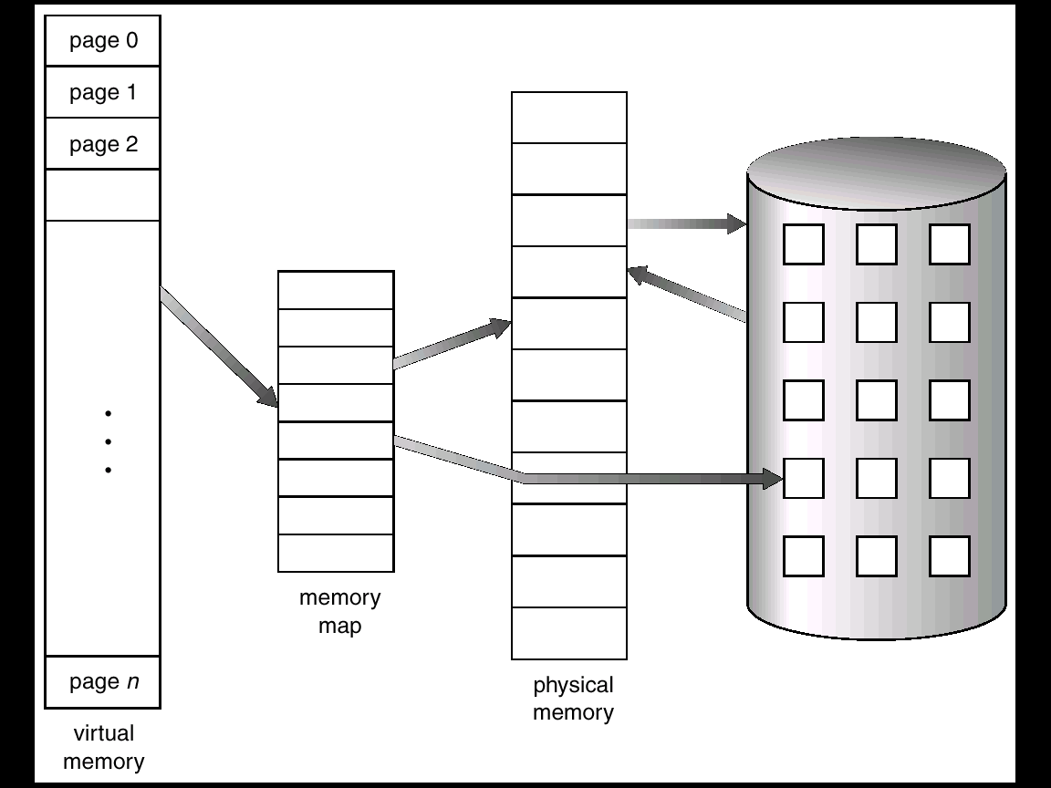
Fig.9.1. Virtual memory that is larger than physical memory

Slide 13
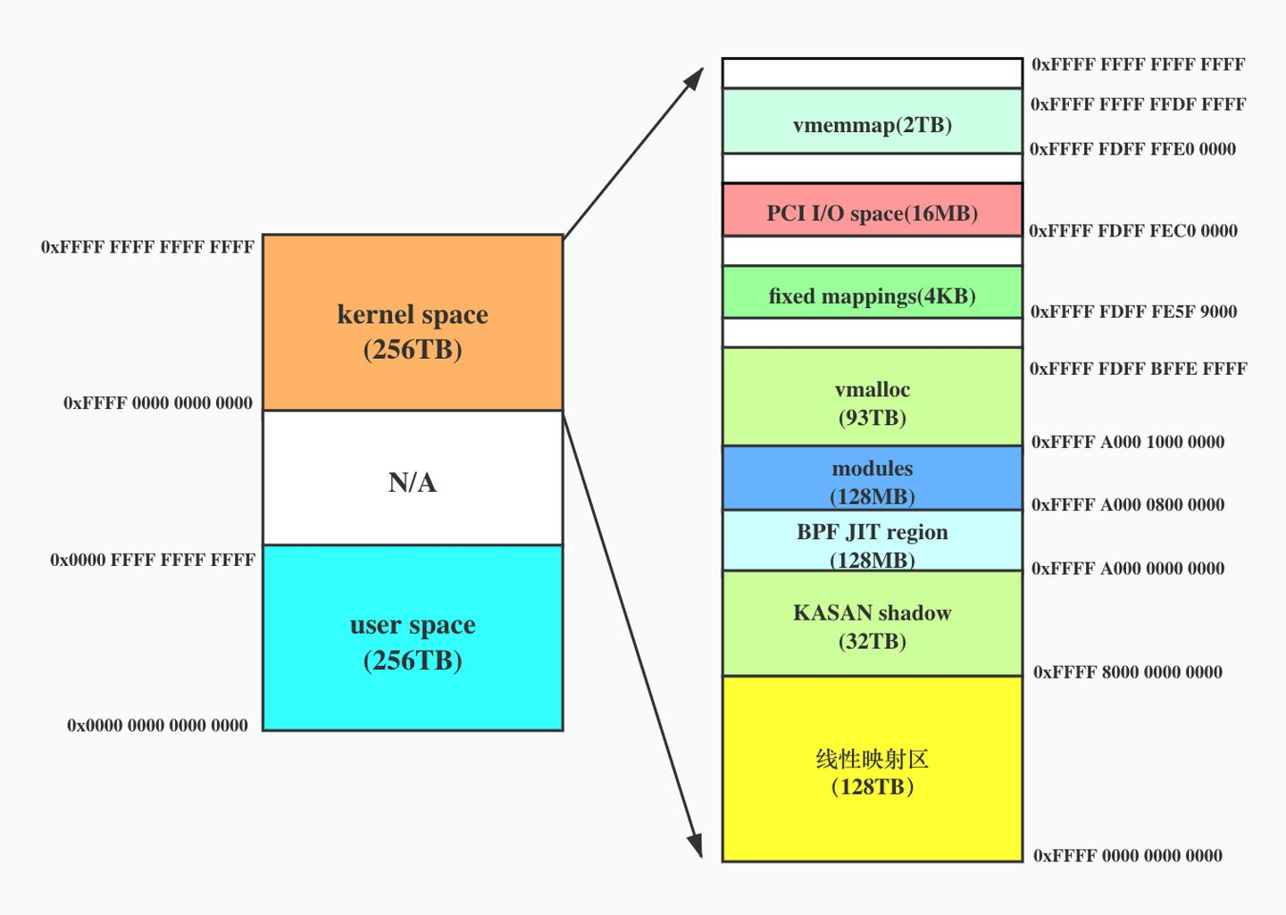
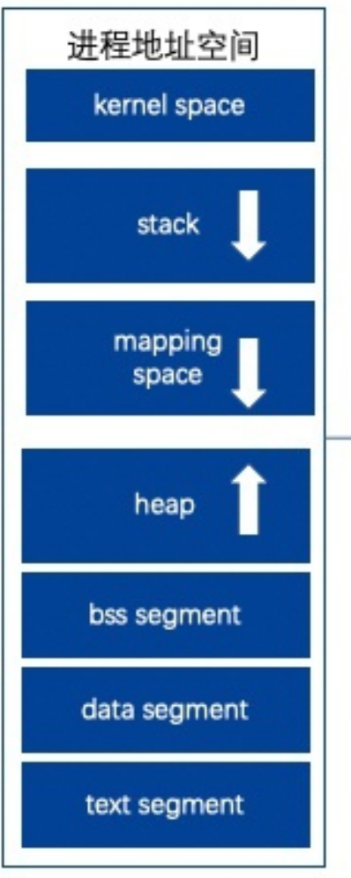
In 64-bit CPU
48-bit logical address
40-bit physical address
User space 256T
Kernel space 256T

Slide 14
32-bit Linux

Slide 15
Virtual memory
Virtual memory – separation of user logical memory from physical memory
Only part of the program needs to be in memory for execution
Logical address space can therefore be much larger than physical address space
Allows address spaces to be shared by several processes
E.g. Fig. 3
Allows for more efficient process creation
E.g. fork() in Unix/Linux
More programs running concurrently
Less I/O needed to load or swap processes
Virtual memory can be implemented via
demand paging
demand segmentation

Slide 16
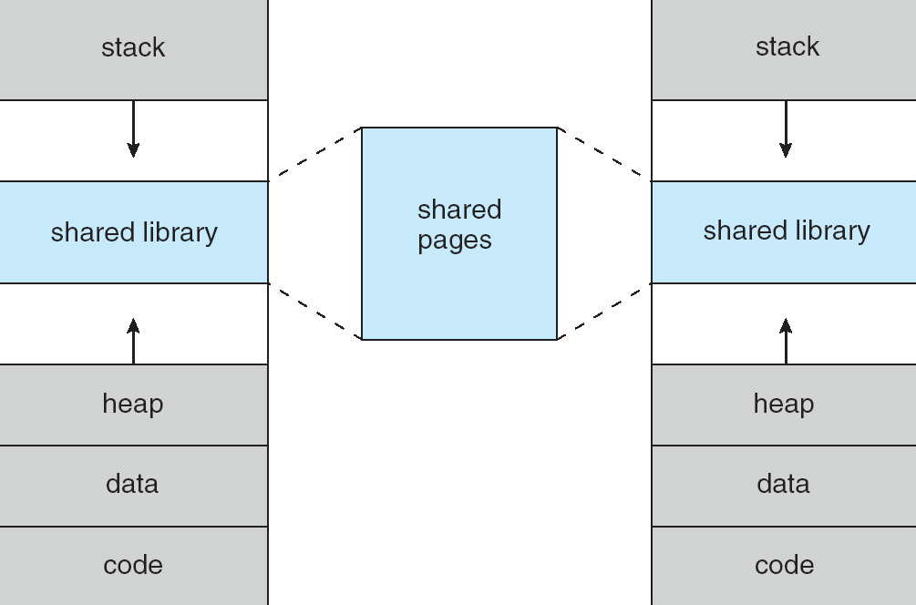
Fig. 9.3 Shared Library Using Virtual Memory

Slide 17
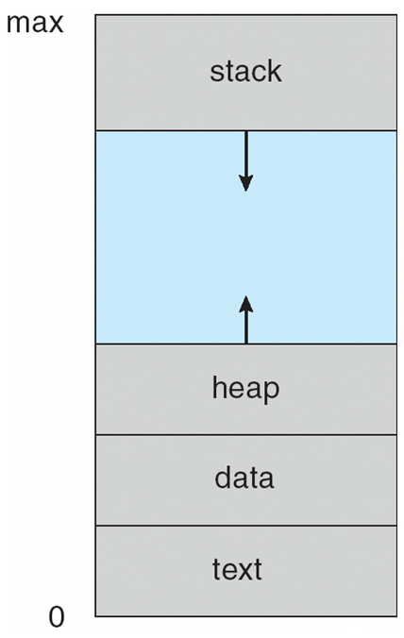
Process (Logical/Virtual) Address Space in Linux
Text section
: program code
Data section
: global variables
Heap
: memory dynamically allocated (e.g. vmalloc) during run time
Stack:
temporary data, e.g. function parameters, return addresses, local variables
Text segment：存储代码指令
Data segment：存储已初始化的全局或静态变量
Bss segment：存储未初始化的全局或静态变量
Heap：堆，用于动态开辟内存空间，brk或malloc开辟的空间
Memory mapping：1. 进程创建时，将程序用到的共享库、平台、动态链接库加载到该区域；2. mmap系统调用使用的空间，用于文件映射到内存或匿名映射（开辟大块空间），当malloc大于128k时（此处依赖于glibc的配置），也使用该区域
Stack：进程运行的栈
Process User Address Space
in Chapter 3
注：Text, BSS, Data段的size在编译时已经确定，可以通过Linux命令查看

Slide 18
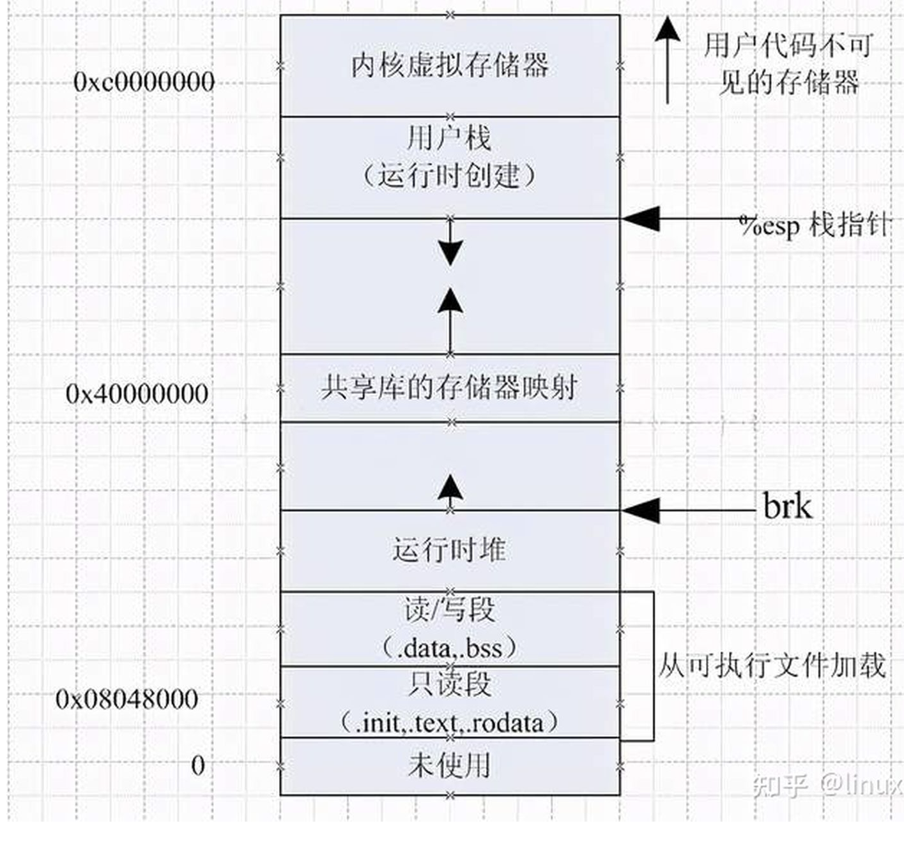

Slide 19
Background
Paging or segmentation vs. Demand paging or demand segmentation
real memory schemes vs virtual memory schemes

Slide 20
9.2 Demand Paging
Principles
进程逻辑空间按页进行组织 (但对用户是非可见的)
进程开始执行之前，只将逻辑地址空间中当前经常反复执行和调用部分所在的pages调入内存, 而其它pages则在进程执行过程中根据需要动态装入--dynamic loading
当进程执行某条指令时，如果该指令不在内存,或执行某条指令过程中需要访问的其它数据或指令时不在内存中时，则发生缺页 (page fault)
OS通过缺页中断 (page fault trap) 从外存（e.g. pagefile in Windows）中将需要访问的指令或数据所在page调入内存
地址变换:
与paging机制类似，系统根据page#查出相应frame#，根据frame#与页内偏移(offset)合并，得到实际物理地址
当缺页中断将某个page调入内存时，如果没有free frame，可通过page replacement为调入的page分配空闲内存
采用与paging类似机制, 实现存储保护与共享

Slide 21
Demand Paging
Bring a page into memory only when it is needed
Less I/O needed, no unnecessary I/O
Less memory needed
Faster response
More users
Demand paging versus swapping
swapping
swap in/out among processes
demand paging
swap in/out among pages of one or more processes

Slide 22
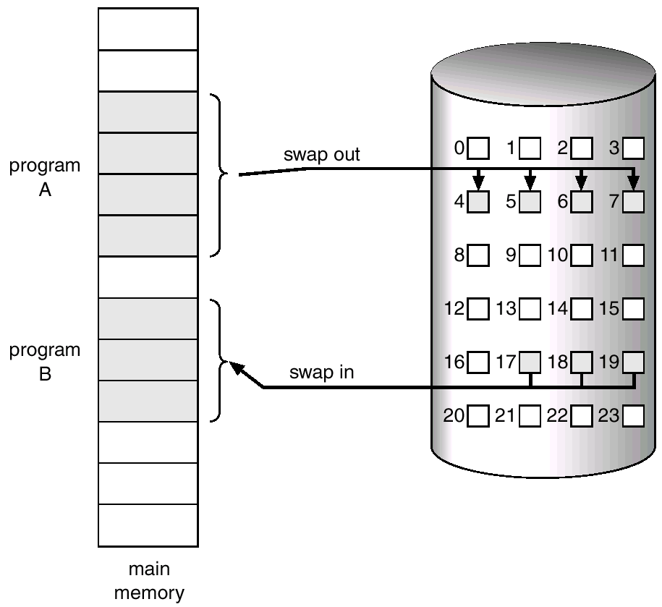
Demand Paging
e.g. pagefile in Windows
Fig.9.4 Transfer of a paged memory to contiguous disk space

Slide 23
Hardware Supports
MMU (e.g. the relocation register) is needed for address translation
Swapping space in secondary memory is needed to store the pages that are not in main memory, (e.g. pagefile in Windows)
The page table is needed, which contains
page# → frame#, for address binding
valid-invalid bit with each page table entry to determine whether pages accessed by processes are
legal or illegal, i.e. in process’s logical address space or not
in memory or in secondary storage
values of Valid-Invalid Bit indicating the associated page
1 ⇒ legal and in-memory,
0 ⇒ illegal or legal but currently on the disk
initially valid–invalid is set to 0 on all entries
E.g. page0, page3 and page6 in Fig. 9.5

Slide 24
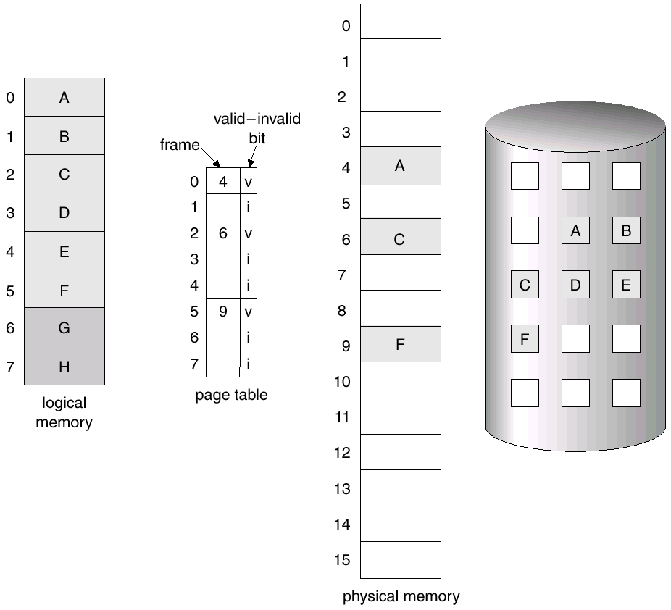
Hardware Supports
Fig.9.5 Page table when some pages are not in main memory

Slide 25
Linux页表项内容
高速缓存
禁止位
修改位
 |  |  |  |  |  | Frame号
访问位
保护位
有效位
有效位
1，代表有效，该表项对应的page在内存中；0，代表无效，对应的page不在内存中
保护位：表示页允许的访问类型，可读、可写、可执行
修改位：0，没有被修改过的干净页；1代表被修改过的脏页，页置换时，脏页需要写回磁盘
访问位:最近该页被访问，置为1，否则为0，用于可支持近似LRU等页置换算法
高速缓存禁止位：是否允许该页被cache缓存

Slide 26
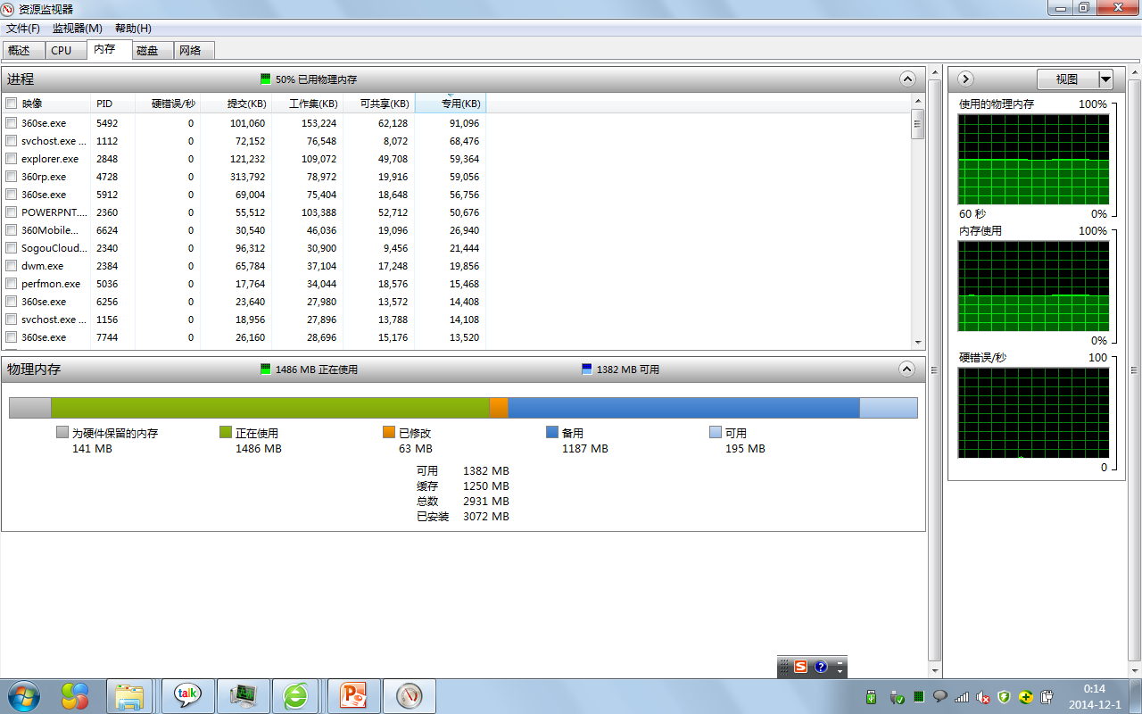
进程工作集 in Windows 任务管理器
工作集（/物理地址空间）
=可共享+专用
提交（逻辑、虚拟地址空间）
>=专用

Slide 27
进程工作集 in Windows 任务管理
Working Set
一个进程可以直接访问到、不引发缺页中断的物理内存
e.g. page0/2/5，frame4/6/9 in the previous slide
专用工作集的内存数量 + 共享工作集的内存数量
专用/私人(private)工作集
工作集的一个子集
进程正在使用、且无法与其他进程共享的内存数量
共享工作集
进程正在使用、且可以由其他进程共享的内存

Slide 28
进程工作集 in Windows 任务管理
提交大小
为进程使用而保留的虚拟内存的数量
，？进程逻辑地址、虚拟地址空间大小
>=专用工作集
峰值工作集
进程所使用的工作集内存的最大数量
工作集增量
进程所使用的工作集内存中的更改量
页面缓冲池
可以写入其他存储媒体（例如硬盘, pagefile）的进程的认可虚拟内存数量
非页面缓冲池
无法写入其他存储媒体的某个进程的认可虚拟内存数量

Slide 29
Process Executing and Page Fault Handling
While the process accesses the pages that are memory resident, i.e. Valid-Invalid Bit =1, execution proceeds normally
Otherwise, that is Valid-Invalid Bit =0, a page fault (缺页) occurs, and the system handles this fault by page fault trap (缺页中断) as follows, refer to Fig.9.6
step1. determine the reference (访问地址) is legal or illegal, on the basis of an internal table in PCB
step2. if the reference is invalid,
then terminated the process
else go to the following steps to swap the demanded page in

Slide 30
Process Executing and Page Fault Handling
step3. get a free frame for the page, from the free-frame list or by page replacement
step4. schedule a disk operation to read desired page into the newly allocated free frame
step5. modify the internal table kept with the process and the page table to indicated that the page is in memory (reset validation bit in the page table to 1)
step6. restart the instruction interrupted by page fault trap
Pure demand paging
start executing a process with no page in memory
never bring a page into memory until it is required
Locality of reference (as described in 9.6.1) prevents the scenario in which multiple page faults per instruction occur

Slide 31
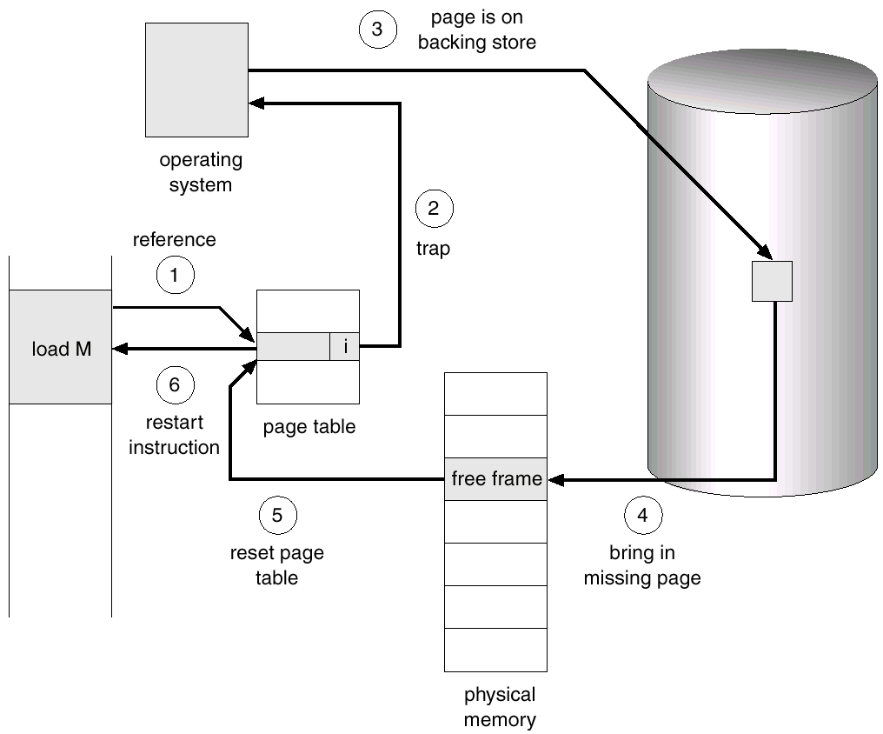
Fig. 9.6 Steps in handling a page fault

Slide 32
Process Executing and Page Fault Handling
The processing sequence of page fault trap is described in page 323-324 in the textbook
CPU mode switch and process context switch
What happens if there is no free frame?
page replacement – find some page in memory, but not really in use, swap it out

Slide 33
Performance of demand paging
Performance criteria
Effective Access Time, EAT
memory access time plus page fault handling time
Page Fault Rate 0 ≤ p ≤ 1.0
if p = 0 no page faults
if p = 1, every reference is a fault
Effective Access Time (EAT)
EAT = (1 – p) ╳ memory access
+ p (page fault overhead
+ swap page out
+ swap page in
+ restart overhead
)

Slide 34
Example One
Memory access time = 200 nanoseconds
Average page-fault service time = 8 milliseconds
EAT = (1 – p) ╳ 200 + p (8 milliseconds)
= (1 – p ) ╳ 200 + p ╳ 8,000,000
= 200 + p ╳ 7,999,800
EAT is directly proportional to the page fault rate
If one access out of 1,000 causes a page fault, i.e. p=0.001, then
EAT = 8.2 microseconds.
This is a slowdown by a factor of 40!!

Slide 35
Example Two
In a demand paging system, the page size is 1024 bytes, and the page table of a process is as follows, would the following virtual addresses (assuming use decimal values) result in a page fault ? and why ?
(1) 2500
(2) 5100
P#
valid/invalid frame number
0
i | 20
v | 15
v | 20
v | 29
i | 80
i | 53
1
2
3
4
5
Answers
(1) the address 2500=2*1024+452 is in page 2, and page2 is valid, so no page fault occurs
(2) the address 5100=4*1024+1004 is in page 4, and page 4 is invalid, so a page fault occurs

Slide 36
9.4 Page Replacement
Basic Scheme
Page Replacement Aigorithms
FIFO
OPT
LRU
Second chance algorithm

Slide 37
Basic Scheme
Over-allocation results in page fault, and page replacement is needed
over-allocation of memory
numbers of pages of all processes in the system exceed the size of physical memory
e.g. Fig. 9.9
By page-fault service and page replacement, a process with large virtual address size can run on a smaller physical memory

Slide 38
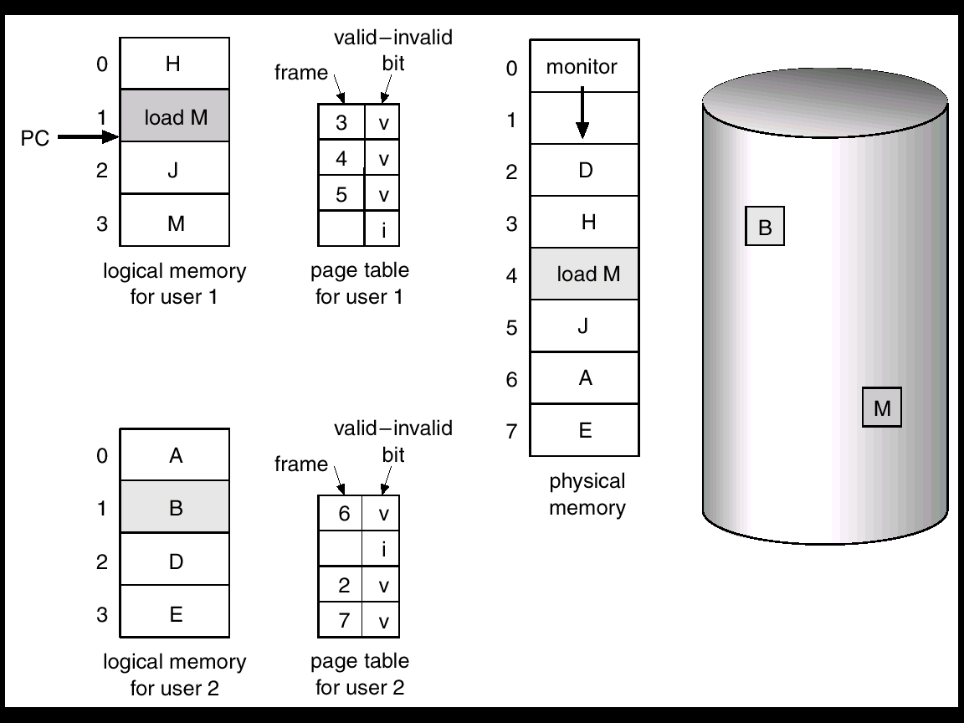
total size of P₁ and P₂: 8 pages
available physical memory for P₁ and P₂:
frame₂ – frame₇
if P₁ executes loads M in page1, a page-fault trap occurs, but there is no free frame for holding M in page₃
Fig.9.9 Need for page replacement

Slide 39
Basic Scheme
Page replacement procedure, Fig. 9.10
step1. find the location of the desired page on the disk
step2. find a free frame
if there is a free frame, use it.
if there is no free frame, use a page replacement algorithm to select a victim frame
swap out the victim page to the disk ; change page and frame tables
step3. read the desired page into the (newly) free frame; Update the page and frame tables
step4. restart the process

Slide 40
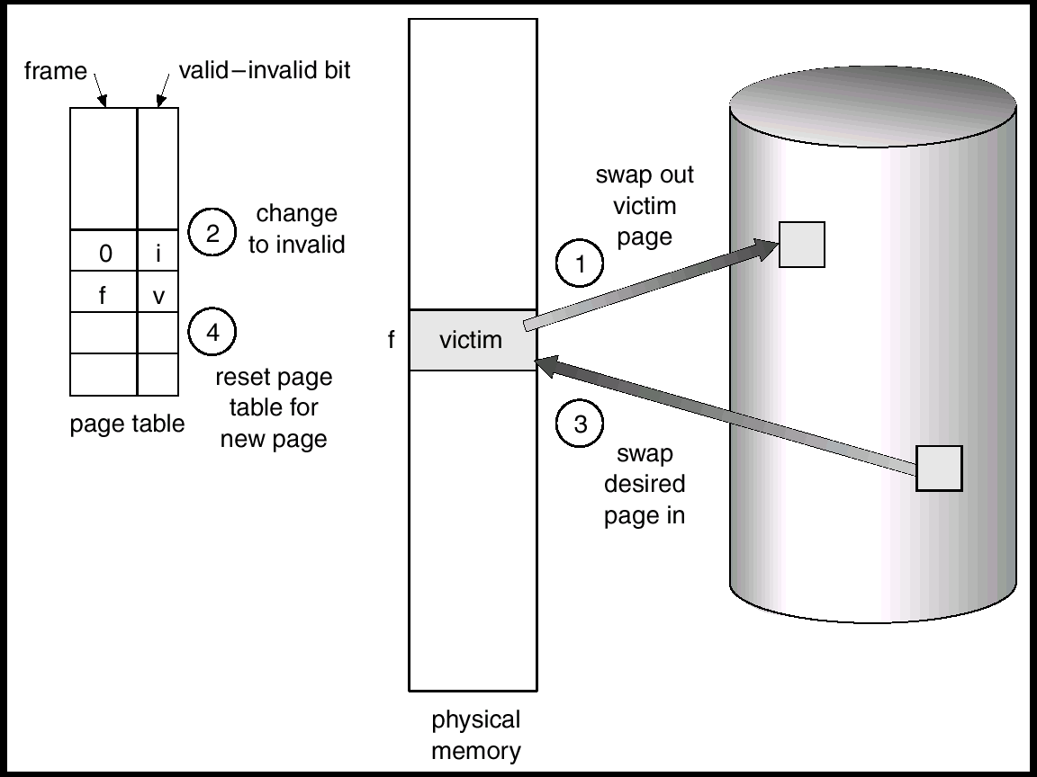
Fig. 9.10 Page replacement

Slide 41
Basic Scheme
Modify (dirty) bit is used to reduce overhead of page transfers
dirty bit, indicating whether or not the contents of the page has been modified
only modified ,i.e. dirty pages in victim frames are written/swapped to disk
if a victim page (e.g. a page contains only instructions) is not modified/written between after being loaded and before being replaced, it should not be swapped out to the disk

Slide 42
Basic Scheme
As mentioned above, two strategies are needed for page fault trap in demand-paging
frame allocation algorithms
page replacement algorithms
Page-fault rate is used as the evaluation criteria for page replacement algorithms
lowest page-fault rate to reduce expensive I/O operations

Slide 43
Basic Scheme
How to evaluate page replacement algorithms
(memory) reference
the number of the pages accessed, i.e. the address of memory units accessed
evaluate the different algorithms by running it on a particular string of memory references (defined as reference string), and then computing the number of page faults on that string

Slide 44
instructions executed sequentially: Load M; ADD X, Y; MOVE X, Y; INC L
Process:
I₁
I₂
I₃
…
I_{n}
reference string: 1,3; 1,4,6; 3,8,10; 2,5
1
e.g. Load M
3
1
4
e.g. ADD X,Y
6
3
8
e.g. MOVE Y,Z
10
2
e.g. INC L
5
i
page i holding an instruction
j
page j holding the operands of an instruction

Slide 45
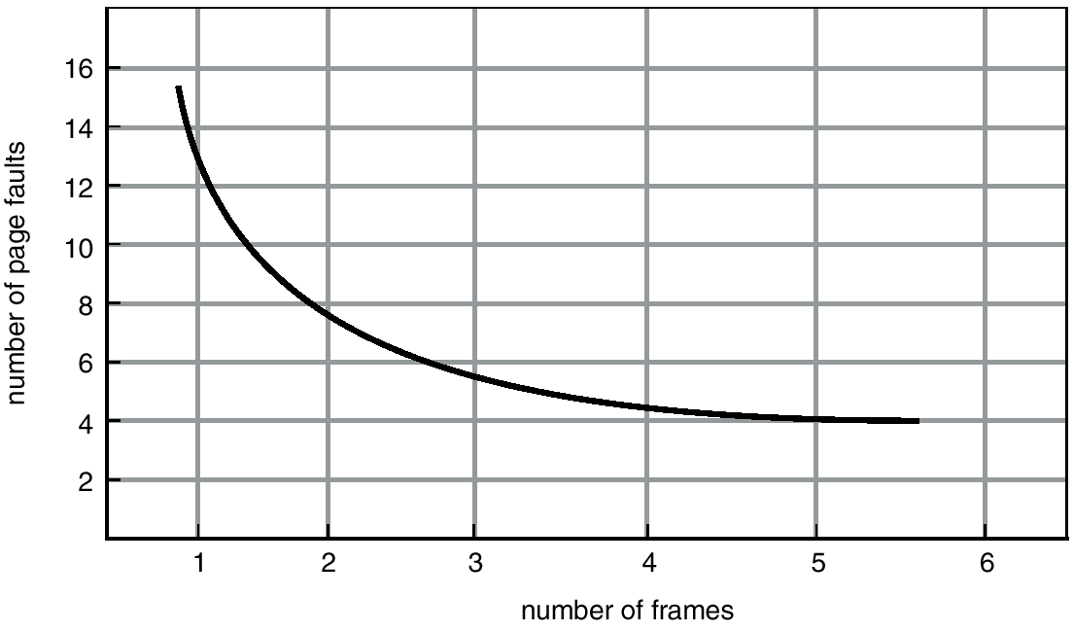
Basic Scheme
A “good” algorithm and evaluation results
with the number of free frames increases, the number of page faults occurring does not increase
similar to that in Fig.9.11, number of page faults vs. number of available frames
Fig.9.11 Page faults vs
the number of frames

Slide 46
Basic Scheme
The test bed for evaluating of the following algorithms
reference string: 20 references
7, 0, 1, 2, 0, 3, 0, 4, 2, 3, 0, 3, 2, 1, 2, 0, 1, 7, 0, 1
three frames available

Slide 47
First-In-First-Out (FIFO)
Principles
the oldest page in memory is replaced
age of page: the time that the page is brought into memory and allocated a allocated a frame
a FIFO queue is used to hold all pages in memory, and the queue length is the number of available frames in memory
when a page is brought into memory, it is inserted into the tail of the queue,
the page at the head of the queue, the oldest page in queue, is selected as the victim and replaced
Evaluation example, Fig.9.12
number of page fault is 15

Slide 48
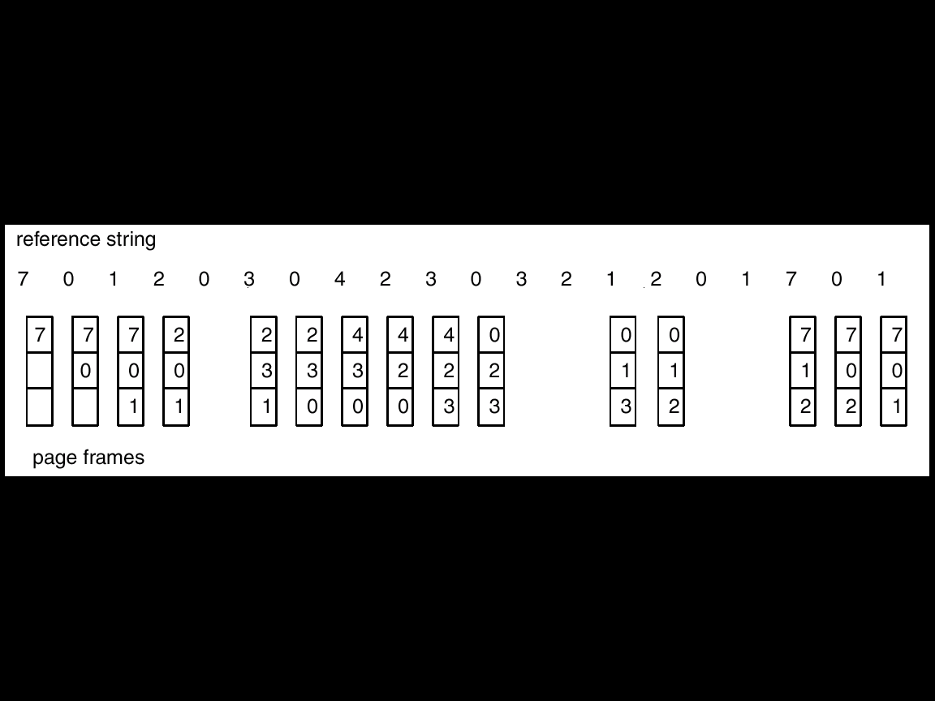
替换(swap out)FIFO队列头部oldest page
新加入(swap in)的page加入队列尾
Fig. 9.12 FIFO Page Replacement
time
7 0 1 2 0 3 0 4 2 3 0 3 2 1 2 0 1 7 0 1
7
7
0
0
7
0
1
0
1
2
1
2
3
2
3
0
3
0
4
0
4
2
4
2
3
2
3
0
3
0
1
0
1
2
1
2
7
2
7
0
7
0
1

Slide 49
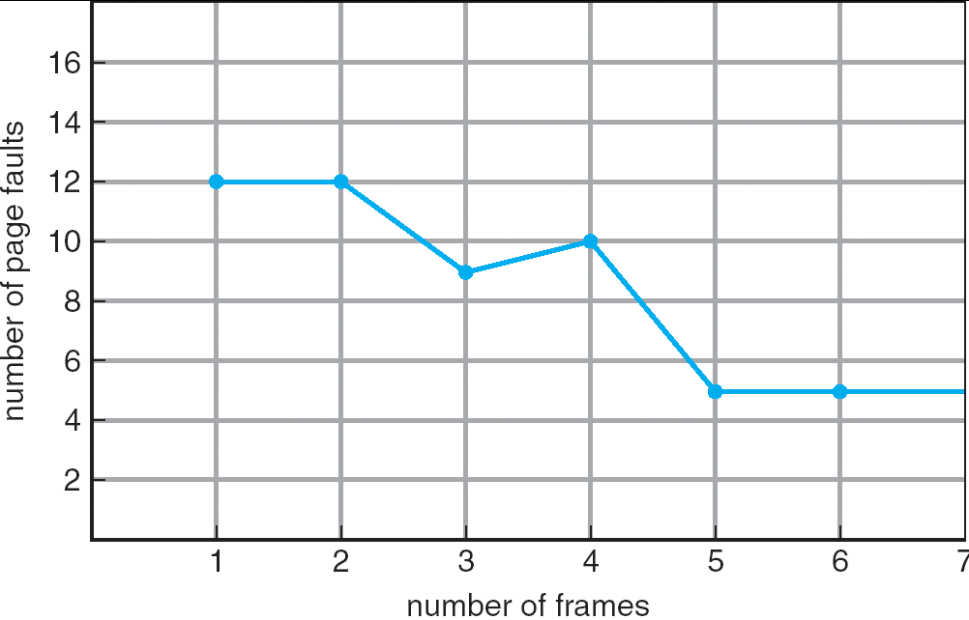
FIFO
FIFO replacement characteristics/demerits
can not avoid Belady’s Anomaly
as the number of the frames increases, page faults rate increases
Fig. 9.13 FIFO Illustrating Belady’s Anomaly with reference string:
1, 2, 3, 4, 1, 2, 5, 1, 2, 3, 4, 5

Slide 50
OPT
Principles
replace the page that will not be used for the longest period of time
also known as OPT or MIN
/* 淘汰在将来再也不会被访问，或最远的将来才被访问的那些页 */
OPT is optimal, having minimum page fault number, compared with other algorithm
never suffering from Belady’s Anomaly
OPT cannot be implemented in practice!
how to know which page will no longer be used ?
As a benchmark or test bed, OPT is used for measuring how well the other algorithms perform

Slide 51
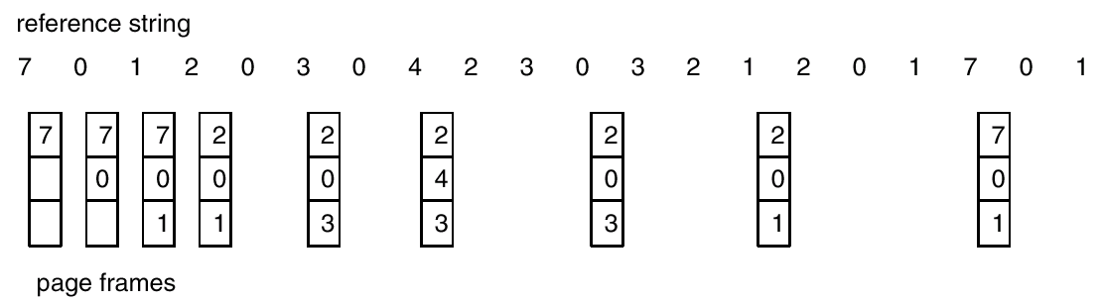
OPT
Evaluation example, Fig. 9.14
the number of page faults is 9
time
Fig. 9. 14 Optimal Page Replacement

Slide 52
LRU
Least Recently Used (LRU) Algorithm (最近最少使用算法)
use past pattern of page references as a predictor of future references
replace the page that has not been used for the longest period of time
/*选择到目前为止，最长时间未被使用的的页；
依据：过去一段时间内未被访问的页，在最近的将来最大可能地也不会被访问

Slide 53
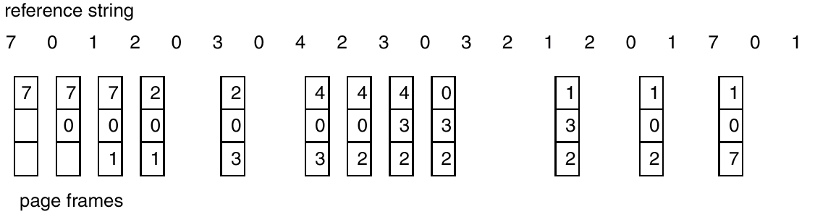
LRU
Evaluation example, Fig. 9.15
the number of page faults is 12
与Fig.9.12 FIFO 对比
time
Fig. 9.15 LRU Page Replacement

Slide 54
LRU
Often used in OS and other areas, e.g. DBMS, with a good performance
e.g. block replacement in DBMS buffer, shown in next slide
Two schemes for LRU implementation
counter
stack

Slide 55
Transaction
data accesses on data item x and y issued by T_{i},
e.g. select, insert, delete, update, …
DBMS
x_{i}, y_{i}
local buffer for T_{i}
逻辑读写
read(x)
write(y)
P_{X}:
the page in buffer,
containing X
P_{X}
P_{Y}
…
P_{Z}
disk buffer
物理读写
input(X)
output(Y) / reflect
DB file on disk
B_{X}
B_{Y}
…
B_{Z}
B_{W}
B_{U}
B_{V}
…
B_{Q}
B_{R}
Fig.13.0.3 read and write operations in Database System Concepts

Slide 56
Second Chance Algorithm
LRU needs sufficient hardware supports, and is difficult to be used in many systems
Some LRU approximation algorithms, which have lower implementation costs, are introduced
second chance algorithm, sometimes known as the clock algorithm
【略：other algorithms: LFU, MFU, second chance page-replacement algorithm, enhanced second chance algorithm】

Slide 57
Second Chance Algorithm: Principles 队列实现方式
FIFO队列，记录进入内存的page号
为队列中每个page维护1个访问标志位，当该page已在内存中，并被再次访问时，将访问位置为1
寻找被换出/swap out的page时，首先查看位于队列头page
如果该page的访问位为0，没有被置位，则该页被选为victim，被置换，新换入的page安排在队列尾
如果该page的访问位为1，将该page置位为0，并移至队列尾（当作1个最近被访问的页），并从新的队列头开始重新寻找被置换的victim
如果队列中所有page的访问标志位都已经被置为为1，那么在从队列头向队列尾的搜索过程中，这些page的访问位将被置为0，并且原本处于队列头的page将再次回到队列头，并被选作victim，从而被换出

Slide 58
Example 1
3 2 3 1 4 3 5 4 2 3 4 3
3
3
2
3*
2
3*
2
1
1
3
4
1
3*
4
3*
4
5
3*
4*
5
3
4
2
3*
4
2
3*
4*
2
3*
4*
2
2
1
3
4*
5
3
the number of page faults is 6
5
3
4

Slide 59
Principles: 另一种实现方式，循环队列实现方式
Generally FIFO, plus hardware-provided reference bit
If page to be replaced has
Reference bit = 0 -> victim, be replaced; and the swapped in page is inserted into the position of the victim in queue
reference bit = 1 then:
set reference bit 0, leave page in memory
replace next page, subject to same rules

Slide 60
Example 2
Given a system with 4 page frames, the following table indicates page, load time, last reference time, modify bit, and reference bit
(1) Which page will be replaced by FIFO? //依据Load time/FIFO队列
(2) Which page will be replaced by LRU? //依据last reference time
(3) Which page will be replaced by the second chance algorithm?
//依据Load time/FIFO队列 + reference bit
Page | Load (into memory )time | Last reference time (the recently time access the page) Loaded page可以被多次referenced | Reference bit
0 | 160 | 370【第2次访问本页，置位reference bit】 | 1
1 | 320: 队列尾 | 320 | 0
2 | 256 | 256 | 0
3 | 150: 队列头 | 340【第3次访问本页，置位reference bit】 | 1

Slide 61
Example 2
(1) page 3,
FIFO select the page loaded first
(2) page 2,
LRU select the page least recently used, and the last reference time of page 2 is 310, 离当前时刻最远，被替换
(3) page 2,
page 3, page 0, page 2 and page 1 are sequentially arranged in the queue; page 3 is at the queue head, and page 1 is at the queue tail
the second chance algorithm first checks the oldest page, page 3, since its reference bit is 1, the bit is reset to 0, and page 3 is moved to the tail of queue. The same thing happens to page 0, the next oldest page
page 2 is then checked, since its reference bit is 0, it is selected as the victim page to be replacement

Slide 62
9.5 Allocation of Frames
Minimum number of frames for process executing
Frame Allocation Algorithms
Global and Local Replacement

Slide 63
Minimum Number of Frames
指令执行完成的前提：
指令本身、操作数必须都在内存中
e.g. LOAD A, X
PC
operator
i
fetch instruction
page_{i}
operand
instruction
page fault
decoding
fetch operand
j
page fault
executing
page_{j}
page_{i} and page_{j}
not in main memory

Slide 64
e.g. LOAD A, X
frame#:
pages:
only one frame,
i.e. frame 10, is allocated
to P₁
operation code
operation code
10
operand
i
operand
p#
0
i | -
i | -
v | 10
i | -
i | -
i | -
i | -
1
i
…
j
j
…
k-1
P₁’s logical addrress space
of size k (>2)
main memory
page table

Slide 65
如果分配给进程的frame数目过少，如只有1个page用于存放进程指令和指令中的操作数，少于其正常执行需要的最低frame数目，进程将陷入某条指令的“取指令-取操作 page-fault”循环中，该指令无法正常执行结束，进程停顿
e.g. 上图中，只分配进程1个frame，指令已在page_{i}中
该指令执行时，CPU陷入page_{i}、page_{j}的“换进-换出”的page fault循环中，
执行停顿
重新执行指令
：用户态
：内核态
取指令
From
pagei
译码
取操作数
page fault
取指令
page fault
取指令
译码
取操作数
page fault
取指令
page fault
操作数page_{j}
置换指令page_{i}
指令page_{i}置换
操作数page_{j}

Slide 66
Minimum Number of Frames
Each process needs minimum number of frames to
meet the requirements of instruction-set architecture, or computer architecture, i.e. to accommodate the instruction and its operands
when a page fault occurs before an executing instruction is complete, the instruction must be restarted
avoid page-fault-rate increasing and slowing process execution.
So, there must be enough frames to hold all pages that any single instruction can reference to, i.e. the pages that operation code and operands reside in !!!
指令执行完成的前提：
指令本身、操作数必须都在内存中

Slide 67
Example One
A machine with all memory-reference instruction having only one memory address, and one-level direct addressing, for example, store_d reg_A to X, where X is a memory unit address
if it is supposed that an instruction and its operands are not allocated across two frames【不跨页存放】, then
minimum number of frames needed is two
e.g. store_d reg_A to 0xFF34CC00 in Fig. 9.0.1
writing register A into memory unit 0xFF34CC00
one frame needed to store the page, in which instruction store_d resides
another page/frame needed to store the page, in which 0xFF34CC00 resides

Slide 68
store_d
reg_A: 11
operation code
00
CC
34
FF
page i
page i
operand
0xFF34CC00
page j
page j
11
(a) direct addressing
(b) store_d reg_A to 0xFF34CC00
Fig. 9.0.1

Slide 69
Example Two
A machine with all memory-reference instruction having only one memory address, and one-level indirect addressing
minimum number of frames needed is three
e.g. store_i reg_A to X
writing register A into the memory unit, the address of which is stored in memory unit X
for instance, store_i reg_A to 0xFF34CC00 in Fig. 9.0.2
one frame needed to store the page, in which instruction store_i resides
one frame needed to store the page, in which 0xFF34CC00 resides and points to 0xEE12DD00
one page/frame needed to store the page, in which the memory unit 0xEE12DD00 resides

Slide 70
store_i
00
CC
34
FF
reg_A: 11
operation code
page i
page i
operand
00
DD
12
EE
0xFF34CC00
page j
page j
Fig. 9.0.2
11
0xEE12DD00
page k
page k
(b) store_i reg_A to 0xFFCC00
(a) indirect addressing

Slide 71
Questions
对双操作时指令
LOAD X, Y
X直接寻址，Y间接寻址，指令、操作数非跨页存放
至少需几个page可以保证该条指令正常执行?
1 + 1 + 2 = 4
指令本身占用1 page
X直接寻址，占用1 page
Y间接寻址，占用2 pages

Slide 72
Minimum Number of Frames
In IBM 370, 6 pages are needed to handle instruction SS MOVE ( or MVC )
instruction is 6 bytes, might straddle 2 pages
2 pages to handle from
2 pages to handle to
The minimum number of frames per process is defined by the (instruction-set ) architecture, whereas the maximum number is defined by the amount of available physical memory!!!

Slide 73
Frame Allocation Algorithms
Two major allocation schemes are used for allocating frames among more than one processes
fixed allocation, priority allocation
Fixed allocation
equal allocation
e.g., if 100 frames and 5 processes, give each 20 frames pages
proportional allocation
allocate frames for processes in proportion, according to the size of each process
Priority allocation
allocate frames for processes in proportion, according to the priority of each process

Slide 74
Frame Allocation Algorithms

Slide 75
Global vs Local Replacement
When multiple processes compete for frames, the page-replacement algorithms can be classified into
global replacement
process selects a replacement frame from the set of all frames; one process can take a frame from another
local replacement
each process selects from only its own set of allocated frames

Slide 76
9.6 Thrashing
Cause of Thrashing(页面抖动/颠簸)
Working-set Model and Locality
Page-fault Frequency

Slide 77
Cause of Thrashing
Thrashing ≡ the high paging swapping activity
a process is in thrashing if it is spending more time on paging (i.e. on I/O) than executing, or
if the frames allocated to the process is not enough, the page in the process may be replaced that will be needed again right away, so the process is busy in swapping pages in and out
颠簸或抖动
在虚存中，页面在内存与外存之间频繁调度，导致内核模式下调度页面所需时间比用户模式下进程实际运行的时间还多，系统效率急剧下降，甚至导致系统崩溃
Definition of thrashing in Microsoft Computer Dictionary
the state of virtual memory system that is spending almost all its time swapping in and out of memory rather than executing application

Slide 78
Cause of Thrashing
Thrashing Causes
page replacement algorithms used are unreasonable
frames allocated to the processes is not enough
进程获得的fram空间少于其正常执行需要的最低frame数目（见9.5.1节），导致进程陷入某条指令的“取指令-取操作 swap-in-out”循环中，指令无法正常执行结束，CPU频繁page fault进程停顿！

Slide 79
Cause of Thrashing
Case1
In Fig. 9.18, with global replacement algorithms, if a process does not have “enough” pages, its page-fault rate will be very high. This process will preempt/take away frames from other processes
the preempted processes must wait for and use paging devices to swap pages in and out, in the waiting state
when these processes wait for paging devices, CPU utilization becomes low
OS then increases CPU utilization by increasing the degree of multiprogramming, i.e. loading new process to the system
if the new process tries to take away frames from running processes, more page faults occur, resulting in thrashing, in which CPU utilization drops sharply

Slide 80
Cause of Thrashing
Case2
For I/O bound processes, when the processes are in waiting state to conduct I/O operations, CPU utilization becomes low,
OS then increases CPU utilization by increasing the degree of multiprogramming, i.e. loading new process to the system
if the new process tries to take away frames from running processes, more page faults occur, resulting in thrashing, in which CPU utilization drops sharply

Slide 81
logical address space:
P₁
P₂
P₃
P₄
P₅
P₆
0
1
2
3
0
1
2
3
0
1
2
3
4
0
1
2
3
0
1
2
3
4
0
1
2
3
4
In line with the instruction architecture in each process,
physical memory size | 10
process | P₁ | P₂ | P₃ | P₄ | P₅ | P₆
the size of logical address space | 4 | 4 | 5 | 4 | 5 | 5
type: I/O or CPUbound | I/O | I/O | CPU | CPU | CPU | CPU
minimum number of frames per process | 2 | 2 | 3 | 2 | 3 | 3
minimum number of total frames required | 15

Slide 82
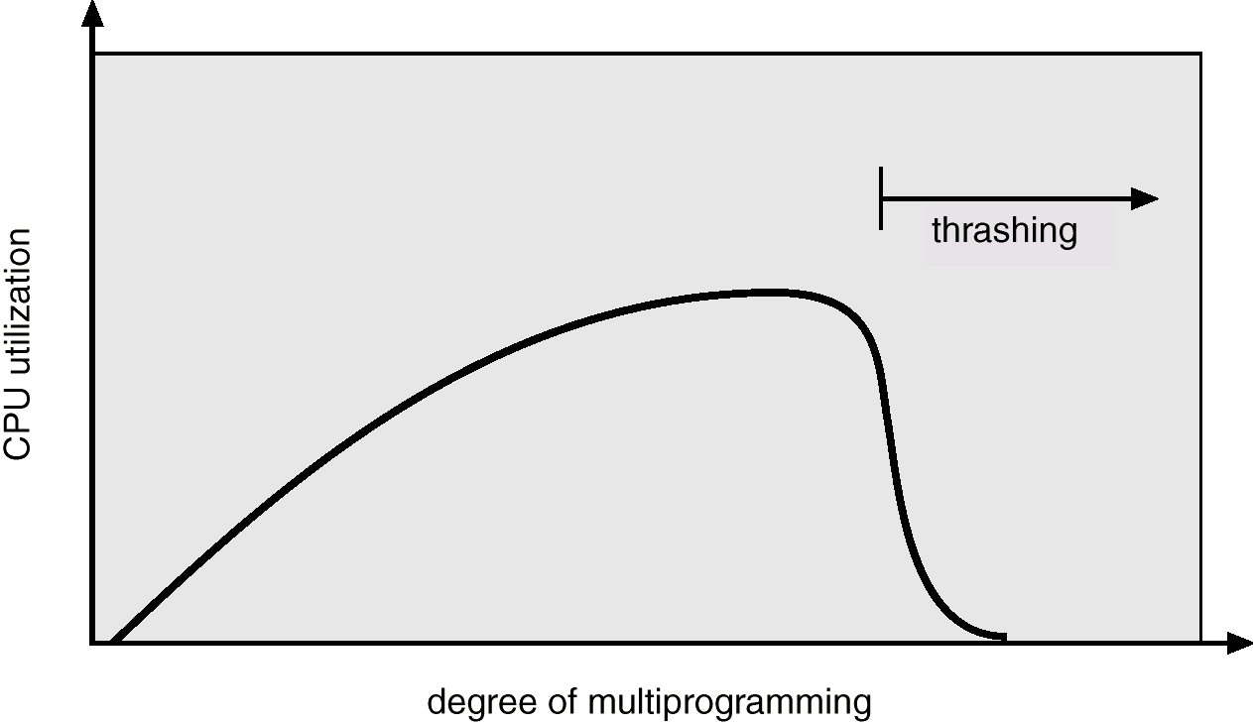
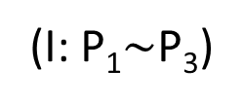
down
up slowly
declining qucikly
increasing
(I: P₁$\sim$P₃)
(II:P₄)
(IV: P₆)
(III:P₅)
Fig. 9.18 Thrashing
当分配给P_{i}的frame数目< 进程所需最小frames, 陷入page fault循环，执行停顿
6 processes are loaded into memory sequentially, and pass 4 stages

Slide 83
The 6 processes are loaded into memory sequentially, and pass 4 stages process sets in each stage:
stage 1. {P₁, P₂, P₃}
stage 2. {P₁, P₂, P₃, P₄}
stage 3. {P₁, P₂, P₃, P₄, P₅}
stage 4. {P₁, P₂, P₃, P₄, P₅, P₆}
1. 初始时，将P₁其逻辑地址空间全部4 pages调入内存，分配4 frames，不会发生缺页中断
2. P₁属于I/O bound进程，当其I/O操作时，CPU利用率降低；
3. 为防止CPU利用率降低，将P₂逻辑地址空间全部4 pages调入，不会发生缺页中断；
4. 当I/O bound进程P₁、P₂同时处于I/O时，CPU利用率降低

Slide 84
为防止P₁、P₂同时处于I/O，降低
CPU利用率，继续调入P₃
down
up slowly
declining qucikly
increasing
(I)
(II)
(III)
(IV)
0
1
3
0
2
4
0
1
2
3
P₂, P₃ 内存不足，缺页中断增加
0
1
2
3
0
1
2
3
0
1
2
3
P₂
P₂
stage (I):
P₁, P₂, P₃ run concurrently, and the utilization increases smoothly
P₃
P₃只获得3个frames，最低需求，运行慢，CPU利用率提高慢
P₁
P₁
P₁
page fault and replacement from P₂ ,P₃ ,
and all processes can proceed
no page fault

Slide 85
down
up slowly
declining qucikly
increasing
(I)
(II)
(III)
(IV)
为防止P₁～P₃同时处于I/O，
CPU利用率降低，继续调入P₄ ，导致P₁、P₃、P₄只能获得最低frame，缺页中断增加，每个进程运行减慢，CPU利用率增长进一步放缓
0
1
3
0
2
4
0
1
2
3
0
1
3
0
2
4
0
1
0
3
stage (II):
P₁, P₂, P₃, P₄ run concurrently, and the utilization increases slowly
P₂
P₂
P₃
P₃
process | P₁ | P₂ | P₃ | P₄
least frames needed | 2 | 2 | 3 | 2
frames allocated | 2 | 3 | 3 | 2
P₄
P₁
P₁
page fault from P₂ and P₃
page fault from P₁～P₄ ; P₁,P₃,P₄ proceed slowly

Slide 86
down
up slowly
declining qucikly
increasing
(I)
(II)
(III)
(IV)
stage (III):
5 processes run concurrently, and the utilization decrease
为解决CPU利用率增长放缓，调入P₅ ，导致P₃和P₅ 获得的frames少于最低需求，执行停顿；P₁、P₂、P₄只获得最低frames，执行缓慢，CPU利用率开始下降
0
1
3
0
2
4
0
1
0
3
0
1
2
0
2
4
0
1
0
3
P₂
P₂
P₅
P₃
process | P₁ | P₂ | P₃ | P₄ | P₅
least frames needed | 2 | 2 | 3 | 2 | 3
frames allocated | 2 | 2 | 2 | 2 | 2
P₃
P₄
P₄
P₁
P₁
page fault from P₁～P₄
page fault from P₁～P₅ , and P₃, P₅ cannot proceed

Slide 87
down
up slowly
declining qucikly
increasing
(I)
(II)
(III)
(IV)
stage (IV):
6 processes run concurrently, thrashing occurs
0
1
2
0
2
4
0
1
0
3
0
1
2
0
2
4
0
1
1
2
P₂
调入P₆ ，导致除P₂ 外， 其它进程获得的frames少于最低需求，执行停顿；P₂只获得最低frames，执行缓慢，CPU利用率急剧下降
P₂
P₅
process | P₁ | P₂ | P₃ | P₄ | P₅ | P₆
least frames needed | 2 | 2 | 3 | 2 | 3 | 3
frames allocated | 1 | 2 | 2 | 1 | 2 | 2
P₅
P₃
P₃
P₄
P₆
P₄
P₁
P₁
page fault from P₁～P₆ , thrashing,
5 processes cannot proceed
P₃, P₅ cannot proceed

Slide 88
Cause of Thrashing
结论
根据系统可用资源，如内存，合理控制系统多道程序设计粒度——并发执行的进程总数

Slide 89
Thrashing vs Deadlock
Thrashing
进程竞争使用内存
内存资源不足，导致进程在running态下陷入swap in/swap out，running-waiting-ready，停滞不前——指令重新执行
Deadlock
进程竞争互斥使用资源，包括内存资源
资源不足，导致进程处于waiting态，停滞不前——进程长久waiting

Slide 90
Cause of Thrashing
In Fig. 9.18, with local replacement algorithms, if a process is thrashing
it can not cause other processes to thrash
the thrashing process will be in the waiting queue for most of time, thus the average service time for a page fault will increase, due to the longer queue for the paging devices
EAT will increase

Slide 91
Working-set Model
To prevent thrashing, a process should be provided as many frames as it needed , if the system knows how many frames it actually need in the near future
A mechanism named as working-set strategy is used to handle thrashing, and estimate the frames that the process need in recent periods
It is based on the assumption of locality

Slide 92
Locality
Two types of locality
Temporal locality
e.g1. a program using a variable (in a page) in a statement is likely to access that variable again in the next few instructions (in the same page)
x := 1;
y :=2;
z:= x + y
e.g.2. an instruction in a loop will be accessed again in a short period of time when the loop cycles back for subsequent iterations
for n=1 to 100 do z:=x+y
x is stored in page i, y is stored in page j, and z is stored in page k, then the reference string is
i, j, i, j, k

Slide 93
Locality
Spatial locality
e.g.1 two variables are typically allocated adjacent memory locations(perhaps locations on a stack). Accessing these two variables results in references to memory locations in close proximity to each other, may be in the same page
int x, y, z
x:=1
y:=1
z:= x+y
e.g.2 sequential execution of instructions results in the next instruction executed being located in a memory location close to the previous location
x
Y
z
x, y, z is stored in page i
then the reference string is
i, i, i, i, i
page_{i}

Slide 94
Locality
结论：
进程执行过程中，在一段“短”时间内，e.g. 100ms , 不可能寻址全部逻辑空间，访问访问局限在一些“局部区域”localities
Why does demand paging work? Locality model
Process migrates from one locality to another
Localities may overlap

Slide 95
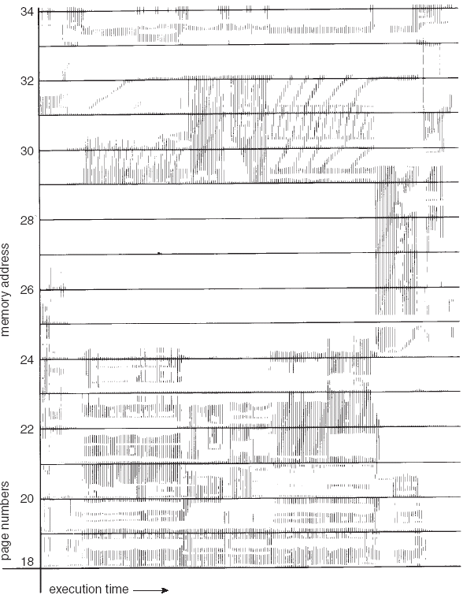
函数
1. [t_{i}, t_{j}]内局限
在5个locality中中，需要的frame数目较多，e.g. 9;
2. [t_{m}, t_{n}]内局限在3个locality，需要的frame数目较多，e.g. 10
3. [t_{u}, t_{v}]内局限在3个locality，需要的frame数目少，e.g. 4
过程
共
享
数
据
区
堆
子程序
主程序
t_{i}
t_{j}
[t_{m}, t_{n}]
[t_{u}, t_{v}]

Slide 96
Locality
Locality assumption!! (or locality model of process execution), as shown in Fig.9.19
Locality
a set of pages that are actively used together in a process, during a time window,
its size is lower than process’s logical space
a program is composed of several different localities, which may overlap
when process executes, it migrates from one locality to another
1 5 2 1 7 2 2 7 11 14 15 5 5 7 3 6 14 6 19 22 3
{1, 2, 5, 7}
{5, 7, 11, 14, 15}
{3, 6, 14, 19, 22}
t
p_{i}
p_{j}
p_{i}
Fig. Reference string and localities during time windows

Slide 97
Working-set and Thrashing
The current locality of P_{i} is the minimum memory need of P_{i}
Why does thrashing occur? For all processes P_{i} ,
D =Σ^{i} (size of current locality for P_{i} )
> available memory size
On the basis of locality assumption, working-set model is used to estimate the size of the current locality of P_{i}, and then be used to prevents thrashing while keeping the degree of multiprogramming as high as possible

Slide 98
Working-set and Thrashing
On the basis of working-set model, thrashing can be prevented
OS monitors the working set of each process, and allocates enough frames to each working set
if there are enough extra frames, a new process can be initiated
if the current sum of the size of each working set increases, exceeding the total number of available frames, to prevent thrashing, one process should be suspended

Slide 99
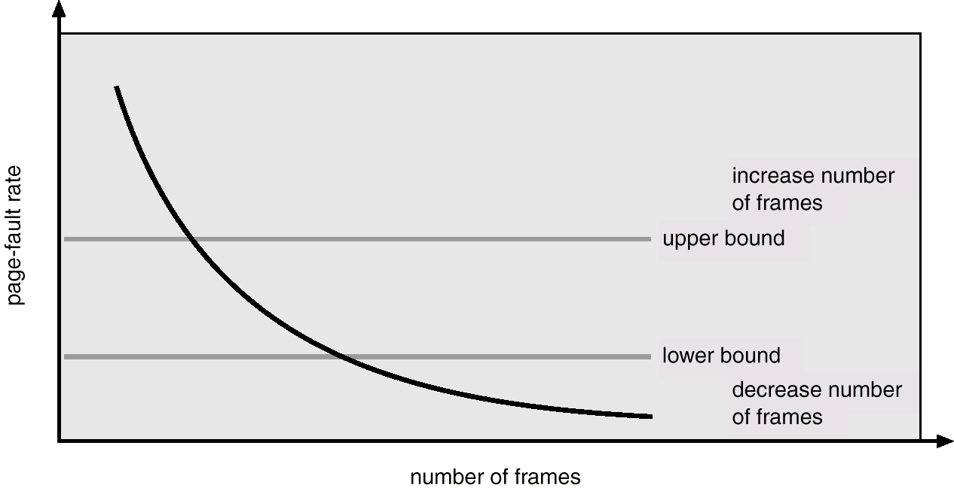
Page-fault Frequency to Handling Thrashing
Establish “acceptable” page-fault rate
If actual rate too low, process loses frames
If actual rate too high, process gains frames
Fig. 9.21
Page-fault frequency

Slide 100
9.3 COPY-on-Write
Virtual memory allows other benefits
copy-on-write (写拷贝) for quick process creation
memory-mapped files (内存映象文件) for quick file access

Slide 101
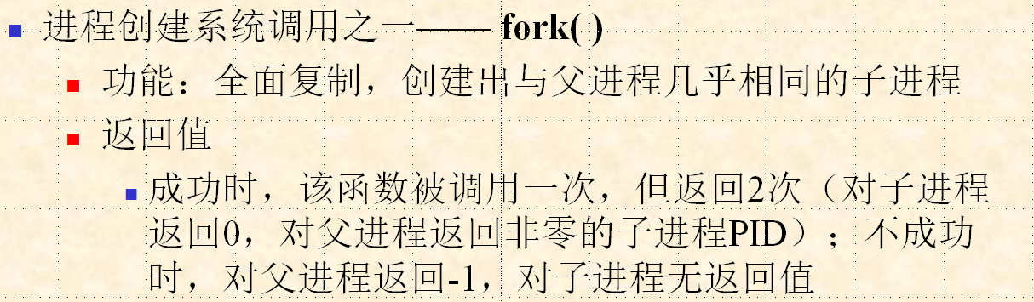
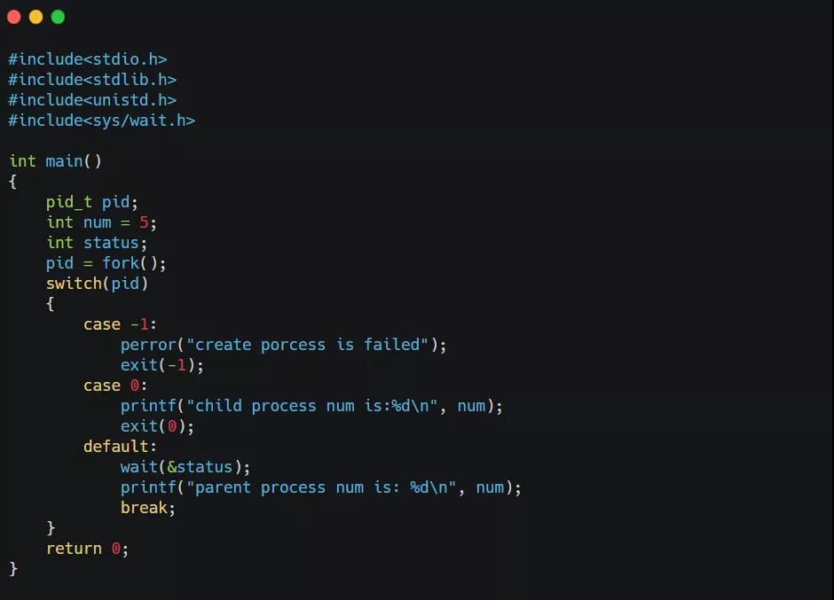
子进程共享父进程的地址空间和num
失败
子进程
父进程
运行结果如下：

Slide 102
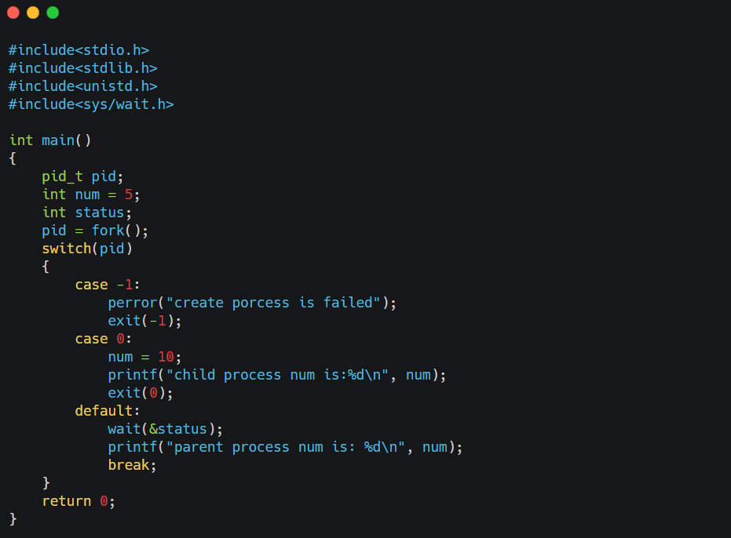
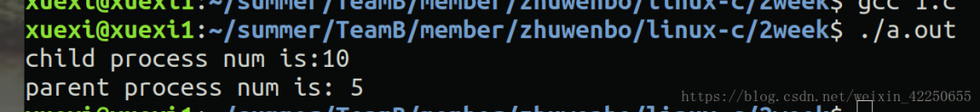
父进程中num保持不变；
子进程中num发生改变：
当子进程修改num值时，fork写拷贝机制，为子进程创建独立进程映像，为nun分配新的存储空间
运行结果如下：

Slide 103
COPY-on-Write
When a parent creates its child, the child duplicates its parent’s pages, and the parent and the child processes initially share some pages
e.g fork() in Linux/Unix
The page that may be modified, such as the page containing data, need be marked as COW page, meaning a non-sharing page

Slide 104
空闲区
空闲区
空闲区
子进程j代码
(新装入)
用户区
父进程i数据
区和栈区
用户区
父进程i数据
区和栈区
用户区
父进程i数据
区和栈区
shared
父进程i代码
父/子进程i代码
父进程i代码
子进程j数据区和
栈区(与父进程
内容完全相同)
子进程j数据区和
栈区(与父进程
内容完全相同)
OS
区
task_struc[i]
OS
区
task_struc[i]
task_struc[j]
OS
区
task_struc[i]
task_struc[j]
(a) fork前的
物理内存
(b) fork后，exec前
的物理内存
(b) fork和exec后
的物理内存
Fig. 9.3.0 fork, exec for process creation

Slide 105
Copy-on-Write (cont.)
The pages initially marked as COW may then mapped into the private space of parent or child, and cannot be shared
The page that may not be modified, and need to be shared by parent and child afterwards, such as the page containing shared executable code, are not be marked as COW
non-COW pages can still shared by parent and children processes
If either process, e.g., the child, wants to modify/writes to a shared page marked as COW, a copy of this shared page is created by OS, and this copy of shared pages is mapped into the private address space of the child that want to writes to the shared page.
The child modifies the copied page, not the shared page belonging to the parent

Slide 106
An Example of COW
There are two processes, parent P_{i} and child P_{j}, the address space of P_{i} consists of (refer to Fig. 9.3.1 (a) )
code section, which will be shared with P_{j}, locating in page5
read-only public data section, which will also be shared with P_{j}, locating in page2
private data section/heap/stack, which is not allowed to be shared with P_{j}, locating in page3

Slide 107
P#
P#
P#
空闲区
空闲区
空闲区
1
1
1
P_{i}数据区
(shared)
P_{i}数据区
shared with P_{j}
P_{i} 、P_{j}数据区
2
2
2
P_{i}堆区
P_{i}堆区
shared with P_{j}
3
P_{i}堆区
3
3
COW
COW
4
4
4
P_{i}代码
P_{i}代码
shared with P_{j}
5
P_{i} 、P_{j} 代码
5
5
6
P_{j}堆区
7
OS
区
task_struc[i]
task_struc[i]
task_struc[j]
task_struc[i]
task_struc[j]
(a) before P_{j} is created
(b) P_{j} is just created
(b) P_{j} writes to its
stack section
Fig. 9.3.1 An Example of COW

Slide 108
An Example of COW
P_{i} creates P_{j} through, e.g., fork(). After just being created, P_{j} shares the address space of its parent P_{i}
page3 are marked as COW, the private heap for P_{j}, these pages will be rewrote by P_{j} afterwards
page2 and page5 are not marked as COW, P_{i} and P_{j} will share and only read these pages
During its execution times, when P_{j} wants to modify/writes to its stack section, i.e. shared pages3, which is marked as COW
a copy of these shared pages, i.e. page7 is created by OS, and mapped into P_{j}’s address space
P_{j} modifies its private heap, i.e. the copied pages7

Slide 109
An Example of COW
After COW is conducted, P_{j}’s address space consists of
code section page5
public read-only data section page2
private stack page7

Slide 110
Copy-on-Write (cont.)
COW allows more efficient process creation
only modified pages are copied
父、子进程的页表项指向同一个内存中frame，但该页标记为COW
/*一个物理页对应了多个逻辑页！
COW is used in Windows2000, Solaris2, and Linux
Refer to Appendix 9-1, for more details about COW

Slide 111
9.7 Memory-Mapped Files
Two mechanisms for secondary storage (files) access
by I/O operations, such as read()/write() system calls
by memory-access instructions, on the basis of memory-mapped file
Memory-mapped file
a file whose storage space (i.e., disk block) is mapped into/ associated with a part of process’s virtual address space/virtual memory
mapping a file disk block to a page in memory
memory-mapping files access can be treated as memory access
/*文件一部分外存空间映射到进程逻辑地址空间/虚拟内存中, 进程利用机器指令，以访问内存的方式访问外存文件，节省IO过程中数据在内存buffer中的缓存次数，提高IO速度

Slide 112
Memory-Mapped Files
Implementation — on the basis of demand-paging
a process prepare to access a page in its virtual memory space, and this page is associated with a file disk block by memory-mapping file
by means of demand paging, a page-sized portion of the file is read from the file system into a physical page
accesses on the file are treated as ordinary memory accesses
e.g. refer to Fig.9.7.1 in next page
Merits
simplifies file access by treating file I/O through memory access rather than read() write() system calls

Slide 113
load A, X: refer to memory vs load A, Y: refer to the file on disk
f#
p#
f#
0
0
0
2 | v
1 | i
3 | v
5 | v
6 | v
2 | i
3 | i
5 | i
1
2
1
2
2
3
frames in
main memory
3
x
4
3
5
5
4
6
x
6
5
Y
7
6
page fault
trap
7
page table
P₁’s virtual
memory
Y
1
3
5
file
in disk
2
Fig. 9.7.1 Memory mapping file access

Slide 114
Memory-Mapped Files
Sharing file by memory-mapped file
Several processes may be allowed to map the same file into their virtual space, to share the data in the file among these processes
by page-sharing in VM, each process points to the same pages of physical memory, also to the pages contains the disk blocks of the files
refer to Fig. 9.23
/* 用内存映象实现文件共享时，共享文件的2个进程可以分别将各自虚拟地址空间中的不同的page利用页表指向physical memory中的同一frame或外存地址空间中的同一block
例如，P₁将page 2# 、P₂将page2# 同时指向frame100# 或block2# (假设block2#调入内存后放在frame100#内)

Slide 115
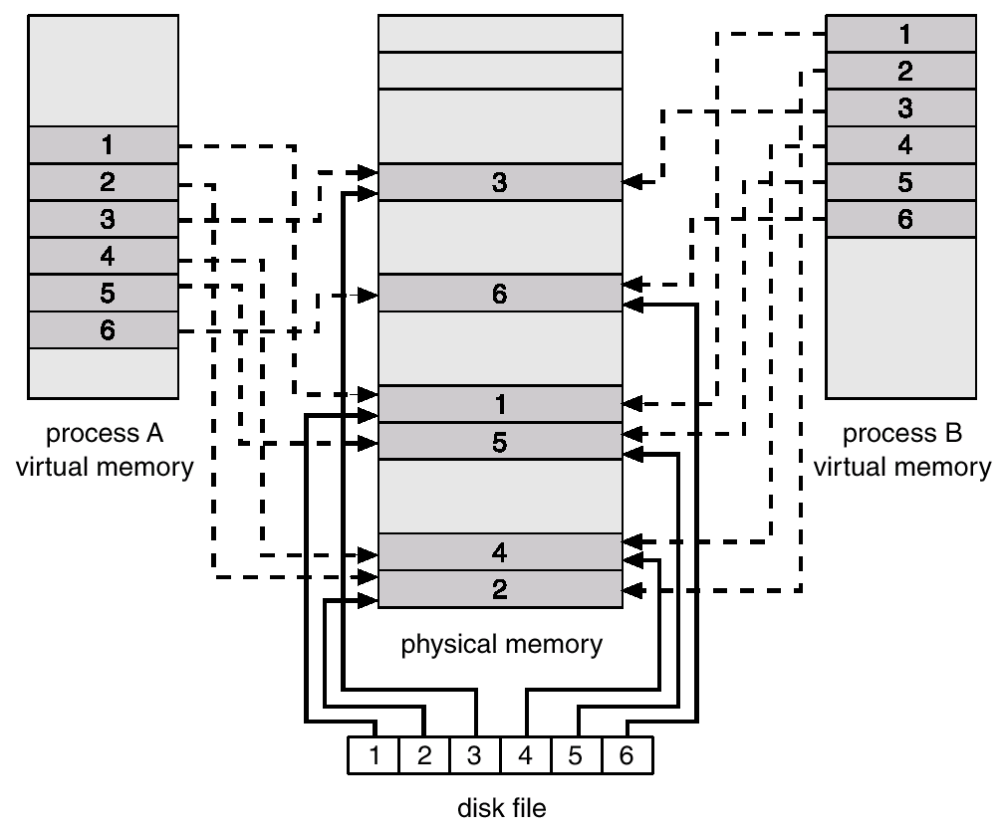
frame100#
Fig. 9.23 Memory-mapped files and file sharing

Slide 116
Memory-mapped file in Linux
/*-------------map_normalfile1.c-----------*/
#include<sys/mman.h>
#include<stdio.h>
#include<sys/types.h>
#include<sys/stat.h>
#include<string.h>
#include<fcntl.h>
#include<unistd.h>
int main()
{
//

Slide 117
int main()
{ //Step1:
int fd=open(“test.txt”, 0_CREAT|0_RDWR, 0644);
write(fd,”testbupt2019CS123456789”, 23)；
//Step2:
struct stat sbuff;
stat(“test.txt”,&sbuff);
char *share=mmap(NULL, sbuff.st_size,PROT_READ,
MAP_PRIVATE, fd, 0);
if (share==MAP_FAILED) {
perror(“map error”)
}
close(fd);
//Step3:
char mapbuffer[10];
memset(mapbuffer,0,sizeof(mapbuffer));
memcpy(mapbuffer,share+4, 10);
//Step4:
putc(mapbuffer);
munmap(share, sbuff.st.size); //length is map size
Step1.创建文件test.txt, 并写入23个字符
Step2.使用函数mmap，将文件映射到进程虚拟地址空间，返回被映射区的指针share;
如果映射失败，mmap()返回MAP_FAILED
Step3-1.用memset清零mapbuffer
Step3-2.指定偏移为4，用memcpy从文件中读取长度为10个字节的内容“bupt2019CS”到mapbuffer
Step4.用putc将mapbuffer内容输出到流/终端中；用munmap删除share处的文件对象映射

Slide 118
mmap(start, length, prot, flags, fd, offset)
start：映射区开始地址，设置为0/null时表示由系统决定映射区起始地址
length：映射区长度。长度单位以字节为单位，不足一内存页按一内存页处理
prot：期望的内存保护标志，不能与文件的打开模式冲突
PROT_EXEC, PROT_READ, PROT_WRITE，页内容可被执行、读取、写
PROT_NONE，页不可访问
flags：指定映射对象的类型，映射选项和映射页是否可以共享
MAP_PRIVATE, 建立一个写入时拷贝的私有映射，内存区域的写入不影响原文件
MAP_FIXED, MAP_SHARED, MAP_DENYWRITE, …
fd：被映射的文件描述符
offset：被映射对象内容的起点

Slide 119
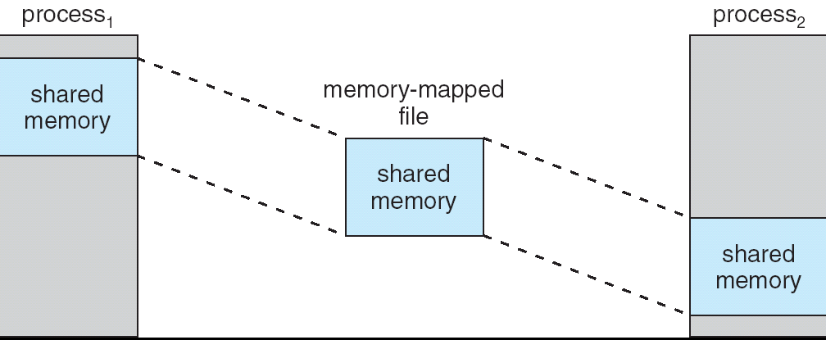
Memory-Mapped Shared Memory in Windows
E.g. C# file-sharing-based inter-process communications

Slide 120
Allocating Kernel Memory
Treated differently from user memory
Physical memory is divided into two parts
one part, in kernel space, in which OS kernel resides
organized as pages, kernel page table (内核页表) is needed
organized as contiguous memory blocks
the other，in user kernel, for application or other system processes
system or
application
processes
kernel
space
kernel

Slide 121
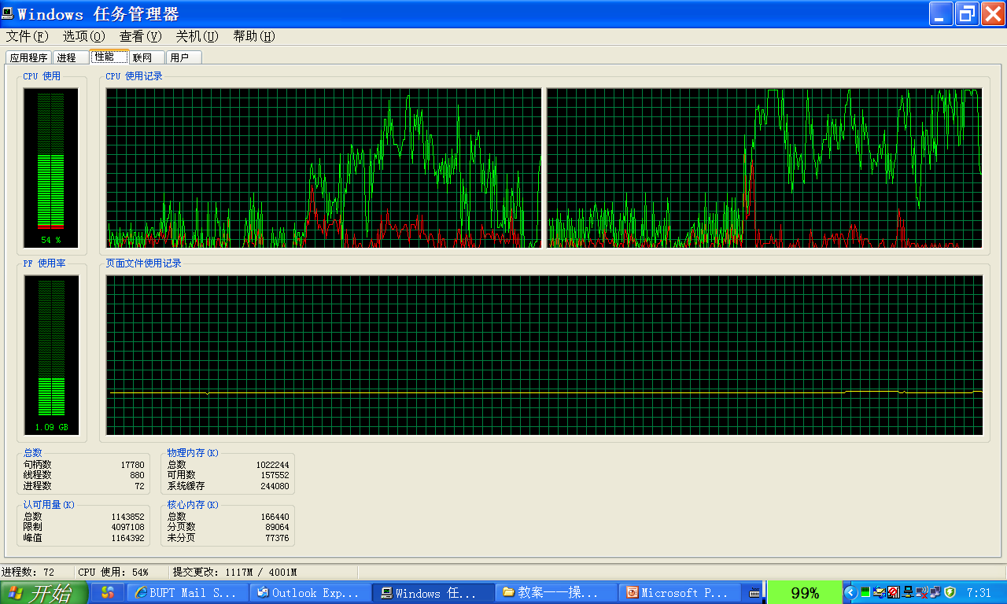

Slide 122
Allocating Kernel Memory
Kernel memory is treated differently from user memory
Memory requested by the kernel is often allocated from a free-memory pool residing in kernel space
kernel requests memory for structures of varying sizes
e.g. when a process is created, OS requests memory to hold its PCB
e.g. when a process defines a new semaphore, the semaphore is stored in kernel space
e.g. message-passing communication, mailbox
some kernel memory needs to be contiguous
I.e. for device I/O

Slide 123
Allocating Kernel Memory
The size of kernel memory requested by processes is not fixed
So fixed-sized partitions of kernel space, such as paging, is also not efficient for kernel space management
Many OS do not subject kernel code or data to the paging system??!!
kernel page table in Linux
Two schemes for allocation of kernel memory, similar to MVT
buddy system, used in Unix
buddy, slab allocator, used in Linux

Slide 124
Linux内核页表
Linux进程的虚拟地址空间有内核空间、用户空间组成，内核空间为OS内核代码和数据
E.g. OS创建进程时，在内核空间分配为新创建的进程分配进程控制块task_struc
内核空间逻辑上分为连续的页，通过内核页表将虚拟地址空间映射至物理内存空间
一般将连续的虚拟地址空间映射到连续的物理地址空间，两者位置上相差offset，利用页表，直接将虚拟地址加上offset得到物理地址
系统创建时，建立这种映射关系
E.g.
x-86下，DMA需要配置内存地址，采用物理地址。DMA driver使用内核内存分配申请到一块内存，其地址为虚拟地址va，与物理地址pa间关系为：va=pa + offset
内核空间一般不做swap；一般内核代码全部加载至内存，也没有page fault（注：vmalloc可能例外）；内核空间映射至连续的物理空间

Slide 125
Linux内核页表
内核页表在系统初始化时创建，记录了虚拟地址空间中从0xC000,0000到0xffff,ffff的1G（？？？）内核空间的物理地址分布。内核页表中每一个页表项描述了1M大小的一段虚拟地址空间的物理地址
用户进程创建时，将内核页表复制到新创建的用户页表中

Slide 126
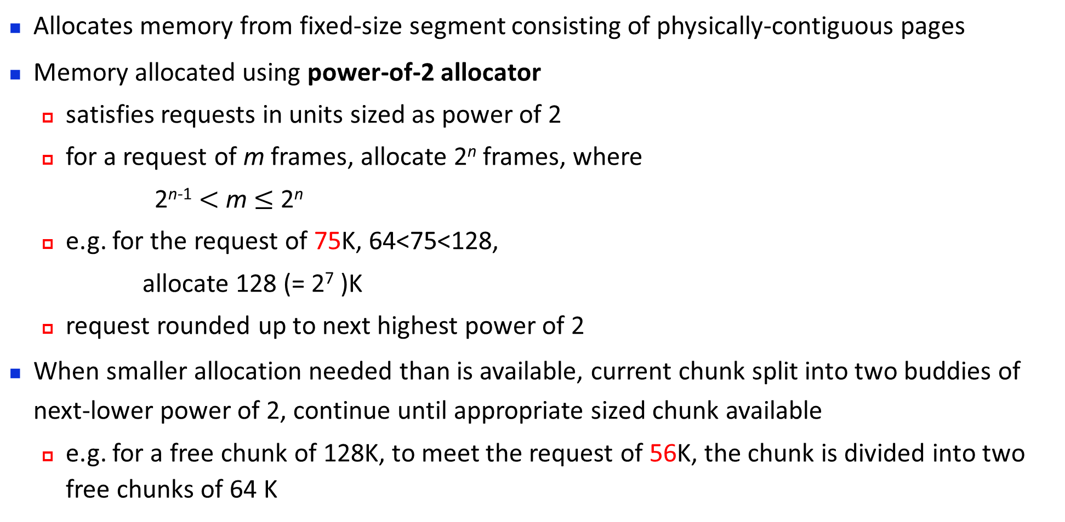
Buddy System
Allocates memory from fixed-size segment consisting of physically-contiguous pages
Memory allocated using power-of-2 allocator
satisfies requests in units sized as power of 2
for a request of m frames, allocate 2^{n} frames, where
2^{n-1} $<$ m $≤$ 2^{n}
e.g. for the request of 75K, 64<75<128,
allocate 128 (= 2⁷ )K
request rounded up to next highest power of 2
When smaller allocation needed than is available, current chunk split into two buddies of next-lower power of 2, continue until appropriate sized chunk available
e.g. for a free chunk of 128K, to meet the request of 56K, the chunk is divided into two free chunks of 64 K

Slide 127
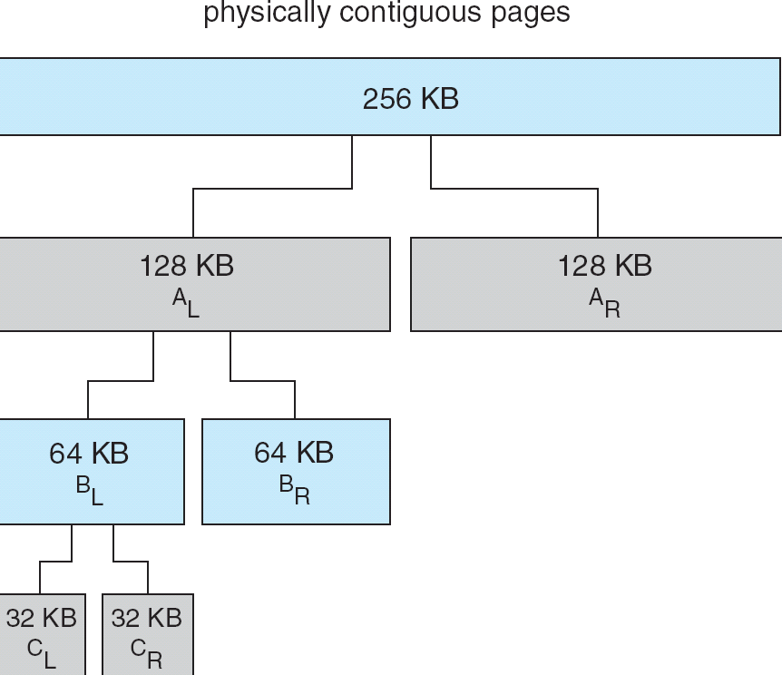
75K
56K
21K
When the kernel releases CL, the system coalesce into a 64-KB segment, ultimately we can end up with the original 256-KB segment
A 21 KB request for PCB is satisfied by the segment C_{L}

Slide 128
Example
For a kernel space with the size of 1M= 2²⁰ bytes, there are 21 segments splited by the buddy system, and these segments can be of the size 2⁰, 2¹, …, 2¹⁹, 2²⁰ respectively

Slide 129
0
128K
256K
384K
holes
数目
512K
640K
768K
896K
1M
初始
状态
A | 128 |  | 256 |  | 512
A | B | 64 | 256 |  | 512
A | B | 64 | C | 128 | 512
128 | B | 64 | C | 128 | 512
128 | B | D | C | 128 | 512
128 | 64 | D | C | 128 | 512
256 |  |  | C | 128 | 512
1024
1
3
3
3
4
3
4
3
1
申请70
申请35
申请80
回收A
申请60
回收B
回收D
回收C
内核空间分布
申请— A: 70K; B: 35K; C: 80K; D: 60K

Slide 130
Slab Allocator
Slab allocator引入
Unix/Linux系统中的buddy分配单位是1个物理页page frame（4KB，page/frame），但通常情况下内核申请分配的内存空间大都为几十或数百个bytes，采用buddy分配，导致严重内部碎片
SLAB allocator：与buddy allocator相配合，分配小块内存
SLAB allocator
firstly introduced in Sun Solaris 2.4 in 1990+
in 2000+, improved as SLUB and SLOB
SLAB, SLUB and SLOB are collectively called SLAB
SLAB is the default memory allocator in Linux-2.6.23 and its successors

Slide 131
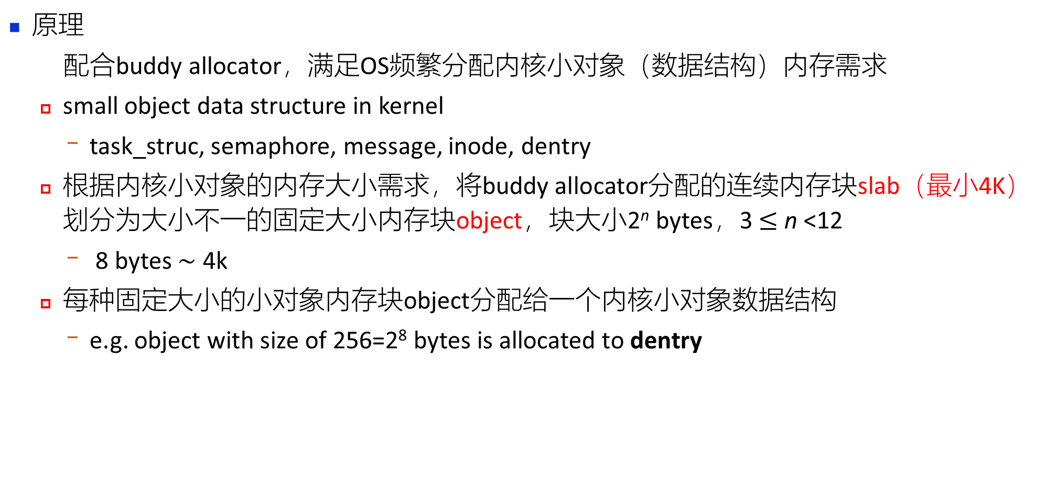
Slab Allocator
原理
配合buddy allocator，满足OS频繁分配内核小对象（数据结构）内存需求
small object data structure in kernel
task_struc, semaphore, message, inode, dentry
根据内核小对象的内存大小需求，将buddy allocator分配的连续内存块slab（最小4K）划分为大小不一的固定大小内存块object，块大小2^{n} bytes，3 $≤$ n <12
8 bytes $\sim$ 4k
每种固定大小的小对象内存块object分配给一个内核小对象数据结构
e.g. object with size of 256=2⁸ bytes is allocated to dentry

Slide 132
Slab Allocator
A slab is one or more physically contiguous pages
allocated by the buddy allocator，由一个或多个page frame组成（通常为一个），4K
divided into small objects with a fixed size 2^{n} , e.g. n=8
dedicated to a particular kennel small object data structure

Slide 133
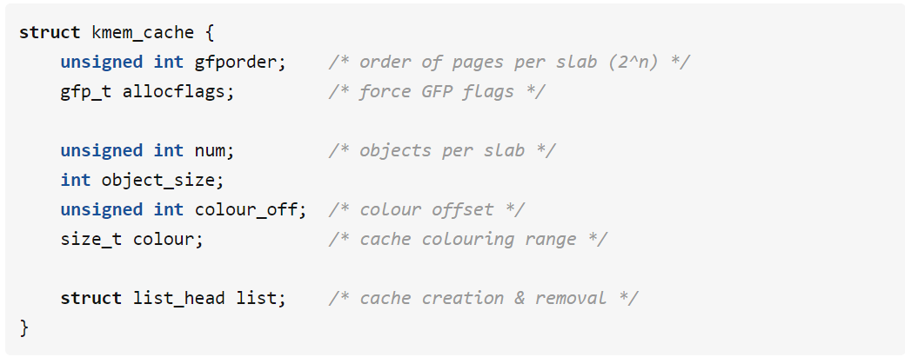
为每种需要申请内存的内核数据结构(e.g. semaphore)建立一个称为cache的内存资源池
A cache consists of one or more slabs, and each slab owns small objects of the same size
cache由Linux中的结构体struc_kmem_cache描述
Single cache for each unique kernel data structure
e.g. for dentry, inode and vm_area_struc
each cache filled with objects – instantiations of the data structure
slab大小, e.g. n=11
slab中object数目， e.g. n=21
object大小, e.g. 0.19K

Slide 134
Page level allocator (buddy)
slab of page frame
cache
cache
cache
partial
dentry_cache
inode_cache
slab
slab
slab
slab
slab
slab
full
已分配
empty
已分配
……….
used object：
free object：

Slide 135
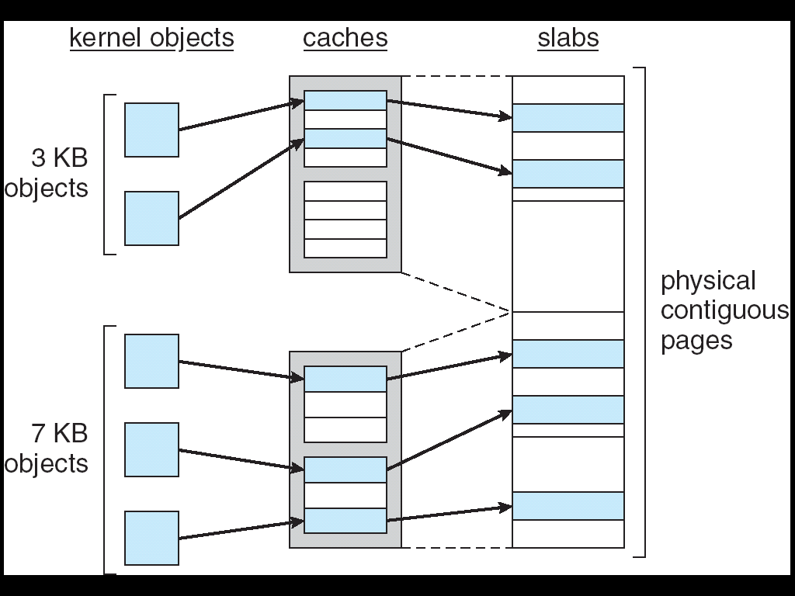
e.g. semaphore
, message
e.g. inode,
open-file
table

Slide 136
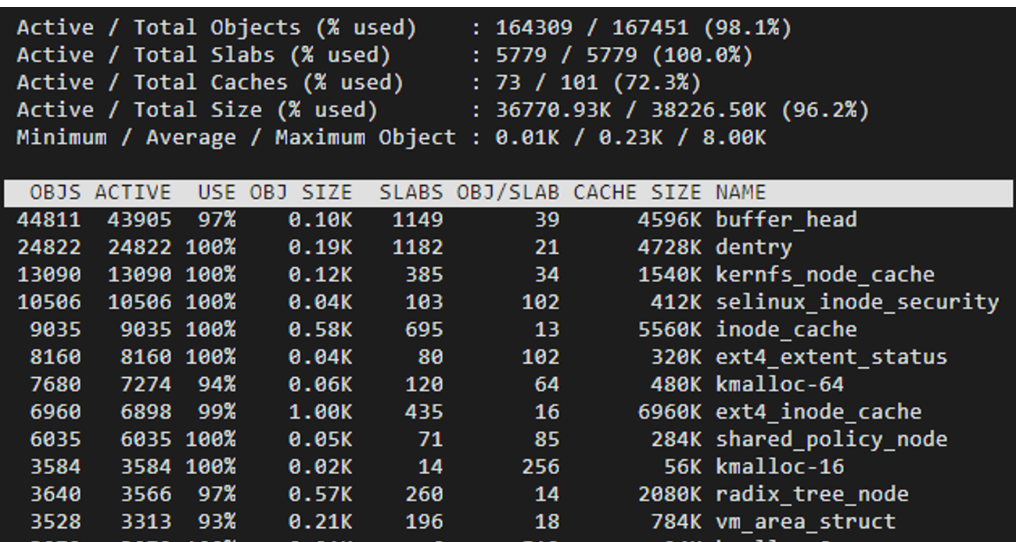
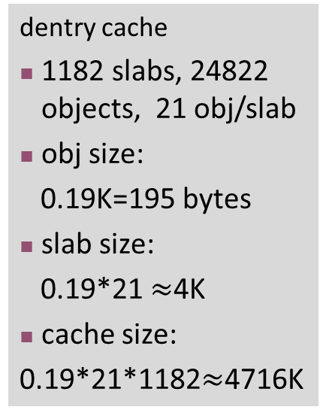
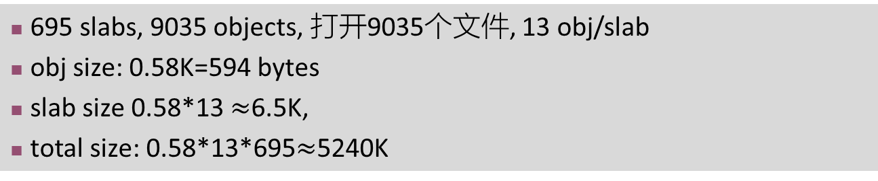
通过"slabtop"命令查看当前系统的slab分配情况：
dentry cache
1182 slabs, 24822 objects, 21 obj/slab
obj size:
0.19K=195 bytes
slab size:
0.19*21 $≈$4K
cache size:
0.19*21*1182$≈$4716K
695 slabs, 9035 objects, 打开9035个文件, 13 obj/slab
obj size: 0.58K=594 bytes
slab size 0.58*13 $≈$6.5K,
total size: 0.58*13*695$≈$5240K
inode_cache

Slide 137
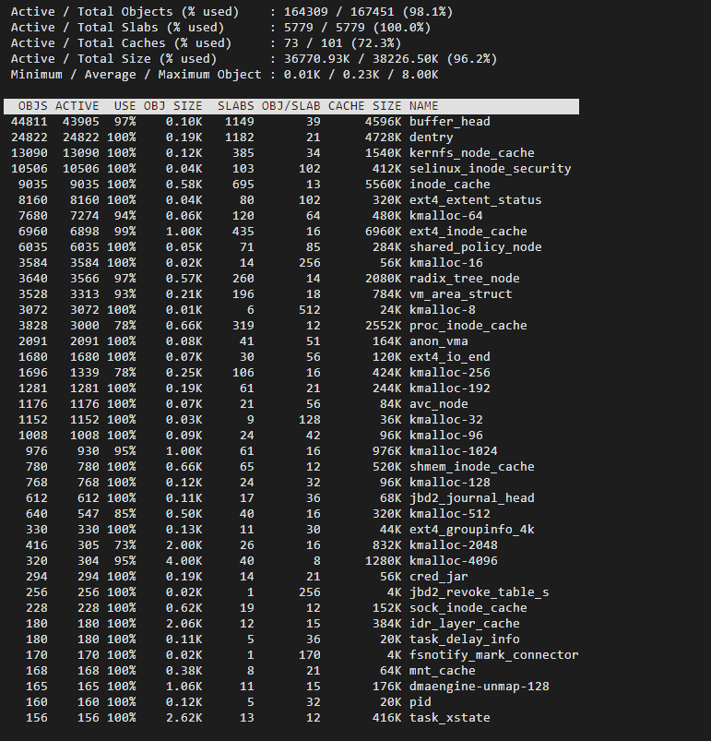

Slide 139
Slab Allocator
When cache created, filled with objects marked as free
When structures stored, objects marked as used
If slab is full of used objects, next object allocated from empty slab
if no empty slabs, new slab allocated
Benefits include no fragmentation (?), fast memory request satisfaction

Slide 141
Appendix 9-1 COW in Process Creation
一个进程的(虚拟)地址空间一般由可执行代码、(私有)堆栈、数据(共享、非共享)、共享内存区(例如用于进程间通信)、共享库等几部分构成。进程的地址空间对应了一定的存储区域。
子进程初始创建时，只是利用页表拷贝的方法(将子进程的页表设置为同父进程页表内容一样)复制父进程的页表，从而将自己的地址空间完全指向父进程的地址空间。子进程同时也复制了父进程的地址空间结构，但各自地址空间结构内的内容今后有可能不同。同时，初始时不需要OS存储管理机制再为子进程分配新的存储空间。

Slide 142
Appendix 9-1 COW in Process Creation
在子进程所拷贝的父进程地址空间中某些页是父进程所独有的 (非共享的)，如父进程自己的堆栈和私有数据结构，这些页应当标志为COW(既非共享数据所在的页标志为COW)，表明不允许子进程访问修改
由于子进程具有与父进程相同的地址空间结构，当子进程在其后的运行过程中需要访问COW页时，表明子进程需要访问自己的堆栈或私有数据结构，但当前访问的是父进程的私有数据结构。因此，OS应当根据COW页为子进程新创建一个页，用于存放子进程自己的私有数据结构。未标识为COW的页允许父进程和子进程共享

Slide 143
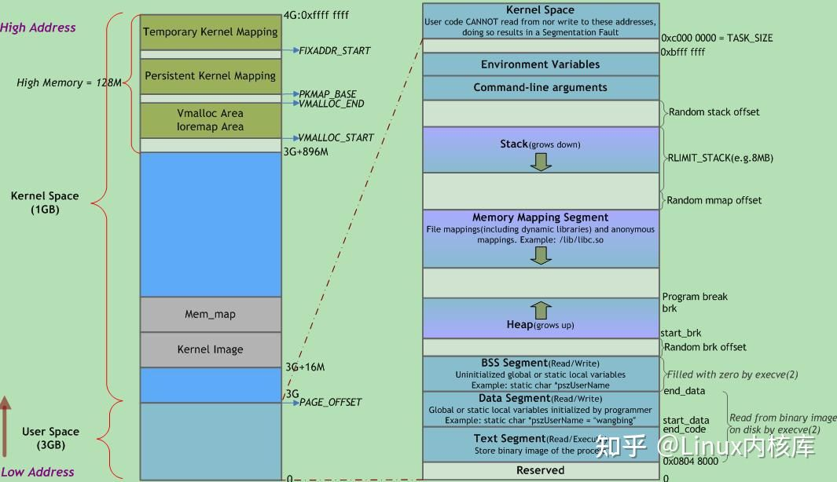
Appendix 9-1 Virtual Address Space in Linux

Slide 145
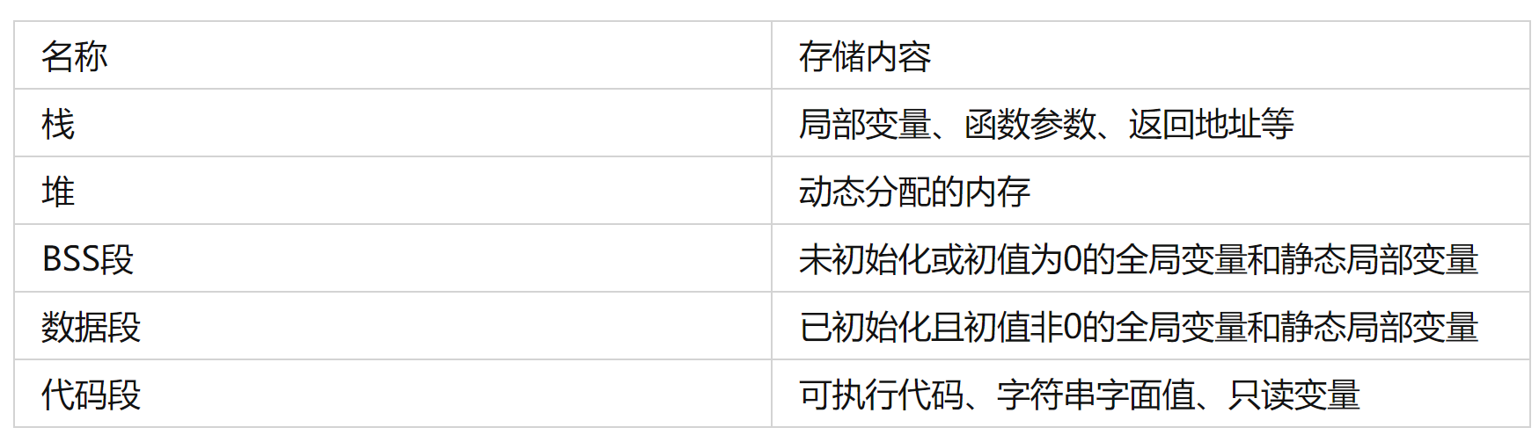
Virtual Address Space in Linux
在将应用程序加载到内存空间执行时
操作系统负责代码段、数据段和BSS段的加载，并在内存中为这些段分配空间
BSS段、数据段和代码段在程序编译时确定
栈stack，由操作系统分配和管理
堆heap，由程序自己管理，显式地申请和释放空间
BSS段、数据段和代码段是可执行程序编译时的分段，运行时还需要栈和堆
execve(2)负责为进程代码段和数据段建立映射，真正将代码段和数据段的内容读入内存是由系统的缺页异常处理程序按需完成的。另外，execve(2)还会将BSS段清零

Slide 146
Virtual Address Space in Linux
1. 代码段(text)
程序可执行代码，字符串字面值，只读变量，一般为只读区域
代码段指令由操作码和操作对象(或对象地址引用)组成。如果操作对象是立即数(具体数值)，将直接包含在代码中；若是局部数据，将在栈区分配空间，然后引用该数据地址；若位于BSS段和数据段，同样引用该数据地址
2. 数据段(Data)
程序中已初始化且初值不为0的全局变量和静态局部变量
属于静态内存分配(静态存储区)，可读可写
3. BSS(Block Started by Symbol)段
未初始化的全局变量和静态局部变量
初始值为0的全局变量和静态局部变量(依赖于编译器实现)
未定义且初值不为0的符号(该初值即common block的大小)

Slide 147
Virtual Address Space in Linux
程序运行时，数据段和BSS段的整个区段通常称为数据区，数据段与BSS段的区别如下：
1) BSS段不占用物理文件尺寸，但占用内存空间；数据段占用物理文件，也占用内存空间
E.g. 对于大型数组如int ar0[10000] = {1, 2, 3, ...}和int ar1[10000]，ar1放在BSS段，只记录共有10000*4个字节需要初始化为0，而不是像ar0那样记录每个数据1、2、3...，此时BSS为目标文件所节省的磁盘空间相当可观
2) 当程序读取不在内存的数据段数据时，系统产生page fault，为数据段数据分配相应的物理内存；当程序读取BSS段的数据时，内核会将其转到一个全零页面，不会发生page fault ，也不会为其分配相应的物理内存

Slide 148
Virtual Address Space in Linux
4.栈stack
存储局部变量、函数参数、返回地址等，用于
为函数内部声明的非静态局部变量(C语言中称“自动变量”)提供存储空间
记录函数调用过程相关的维护性信息，称为栈帧(Stack Frame)或过程活动记录(Procedure Activation Record)，包括：函数返回地址，不适合装入寄存器的函数参数及一些寄存器值的保存
除递归调用外，堆栈并非必需。因为编译时可获知局部变量，参数和返回地址 所需空间，并将其分配于BSS段
临时存储区，用于暂存长算术表达式部分计算结果或alloca()函数分配的栈内内存
每个进程/线程都有属于自己的栈，栈的内容随着线程执行动态变化（增长，收缩）
栈有最大值限制RLIMIT_STACK(通常是8M)，使用Linux命令ulimit -s可查看和设置堆栈最大值

Slide 149
Virtual Address Space in Linux
5.堆heap
存放进程运行时动态分配的内存段，由程序自己控制，可动态扩张或缩减
调用malloc(C)/new(C++)等分配内存时，新分配的内存动态添加到堆上(扩张)
调用free(C)/delete(C++)等释放内存时，被释放的内存从堆中剔除(缩减)
堆管理器通过链表管理程序申请的内存，由于堆申请和释放是无序的，最终会产生内存碎片。堆内存一般由应用程序分配释放，回收的内存可供重新使用。若程序不释放，程序结束时操作系统可能会自动回收
堆中内容是匿名的，无法按名字直接访问，只能通过指针间接访问
堆的末端由break指针标识，当堆管理器需要更多内存时，可通过系统调用brk()和sbrk()来移动break指针以扩张堆，一般由系统自动调用
堆使用时经常出现两种问题：
内存破坏：释放或改写仍在使用的内存
内存泄漏：未释放不再使用的内存。释放次数少于申请次数，可能造成内存泄漏

Slide 150
Virtual Address Space in Linux
6. 内存映射段(mmap)
将硬盘文件的内容直接映射到内存—内存映射文件
应用程序使用Windows CreateFileMapping()/MapViewOfFile()或Linux的mmap()系统调用建立这种映射
内存映射是一种方便高效的文件I/O方式， 被用于装载动态共享库。内存映射段用于映射可执行文件用到的动态链接库
用户也可创建匿名内存映射，该映射没有对应的文件, 用于存放程序数据
在 Linux中，通过malloc()请求一大块内存，C运行库将创建一个匿名内存映射，而不使用堆内存。”大块” 意味着比阈值 MMAP_THRESHOLD还大，缺省为128KB，可通过mallopt()调整

Slide 151
Virtual Address Space in Linux
7. 保留区
位于虚拟地址空间的最低部分，未赋予物理地址
对它保留区的引用都是非法，用于捕捉使用空指针和小整型值指针引用内存的异常情况
参考文献
Linux虚拟地址空间布局，知乎
实验：观察进程虚拟地址空间内的变量、数据分布

Slide 152
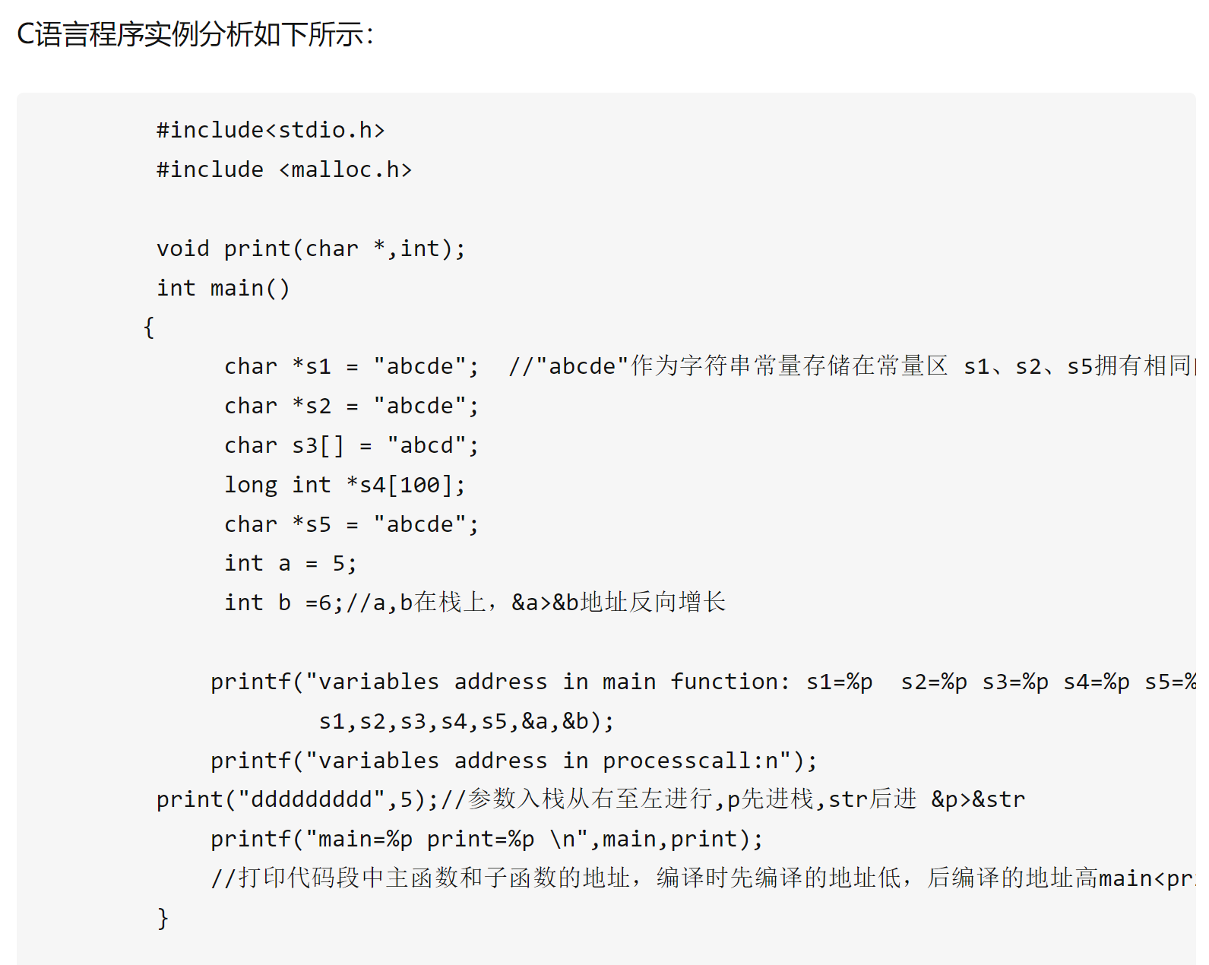
实验：观察进程虚拟地址空间内的变量、数据分布

Slide 153
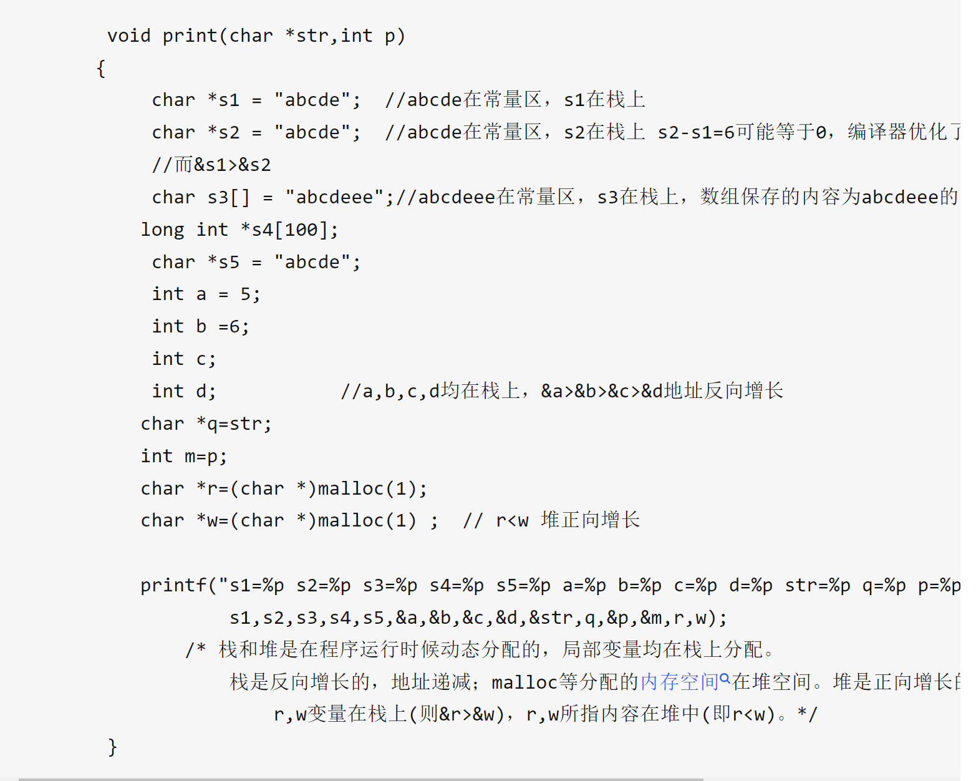
C语言程序实例分析

Slide 155

Thanks for your attention

